Slide 1
Price f(x) – Cuba Libre Release
April 2018

Slide 2
Release Highlights
QC + PM + RM Improvements
PB Improvements
PA Improvements
Workflow Improvements
Other Improvements
AGENDA

Slide 3
Release Highlights
Cooperation on Document Creation
Users can cooperate on creating a Quote, Contract or Rebate Agreement using a document creation workflow – while the document remains Draft
Example: User 1 is required to fill in the Header information, then sends it to User 2 who should add Products, sends it to User 3 to enter Cost data.
Enabled in Configuration per document type Driven by a special type of logic ‘Creation Workflow’
Available for QC, RM and PM

Slide 4
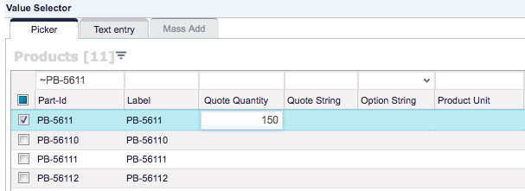
Release Highlights
Faster Work with Inputs
Define a list of user inputs that will always be displayed in Quote‘s Product picker
Users can select products and enter e.g. quantity in one step
Enabled with application property 'quoteItemSelectorInputs‘
Supports only:
USERENTRY
STRINGUSERENTRY
OPTION input types

Slide 5
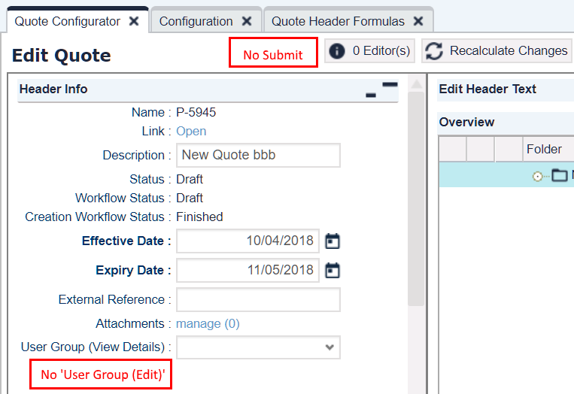
Release Highlights
More Control over Header Fields
Editability and visibility of Header fields in the Detail view can be configured
Save/Submit buttons can be hidden
Applies to:
QC (Quotes)
PM (Contracts)
RM ( Agreements)

Slide 6
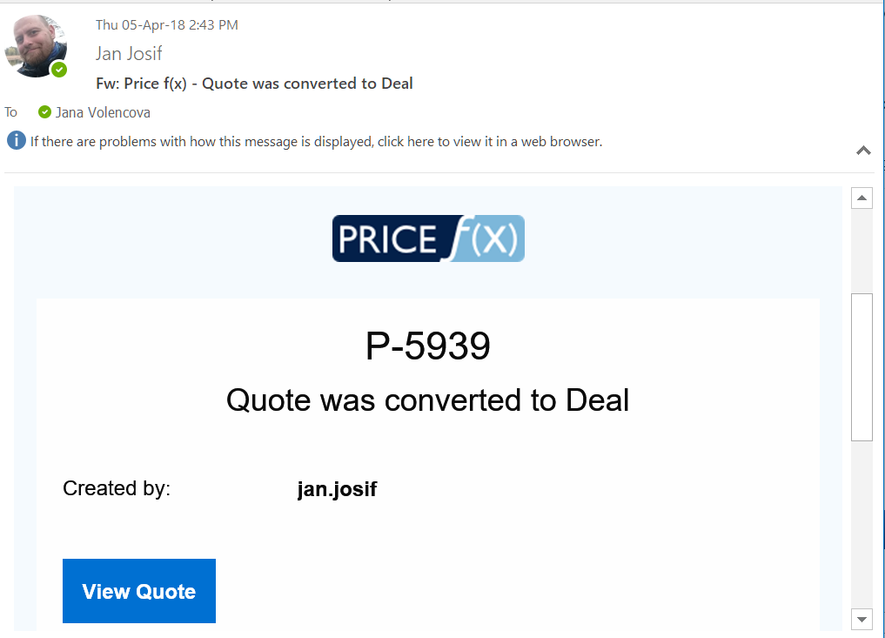
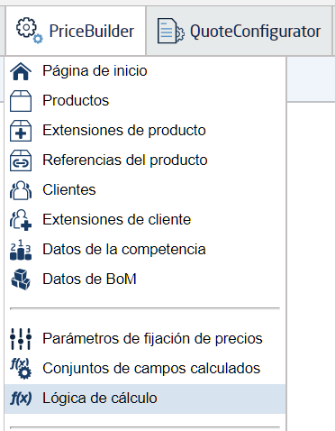
Release Highlights
I18n Support
French, Spanish and Czech added in UI
Email message templates can be created in any language & with enhanced design

Slide 7
Release Highlights
QC + PM + RM Improvements
PB Improvements
PA Improvements
Workflow Improvements
Other Improvements
AGENDA

Slide 8
QC + PM + RM Improvements
Custom PDF File Name
Define the name pattern of PDF output files – add your own sufix to the unique name
Add the targetFileName element to the preprocessing logic

Slide 9
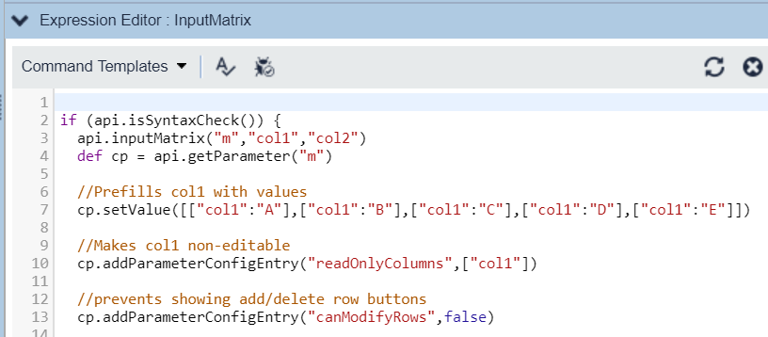
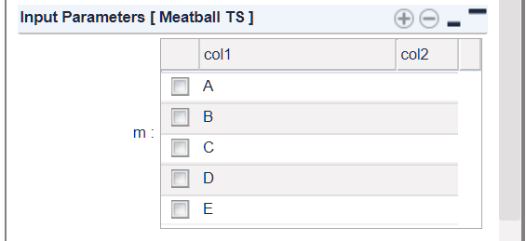
QC + PM + RM Improvements
More Control over Input Matrix
Columns can be made non-editable / pre-filled with default values
Rows can be protected from adding/deleting by users

Slide 10
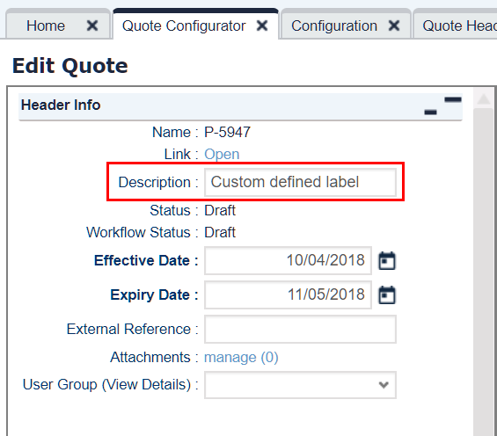
QC Improvements
More Customizations of a Quote
You can set a default custom quote description – made of e.g. the customer name and the current date
Via a label field in the header logic.

Slide 11
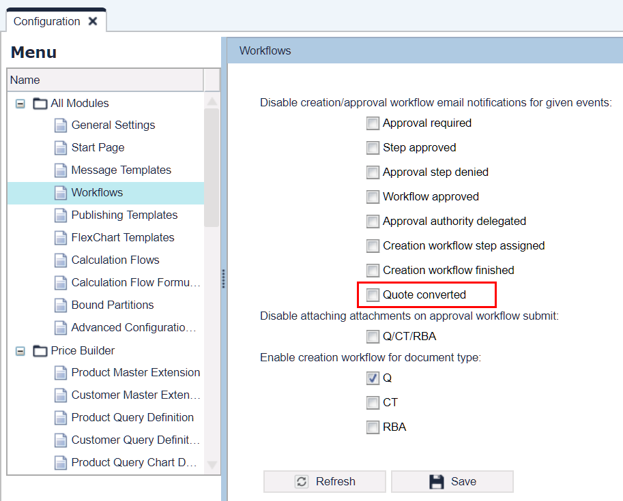
QC Improvements
Better Informed Users
New message template – when a quote is converted to deal
Notification is sent to quote creator and submitter

Slide 12
QC Improvements
Smarter Work with Dates
New behavior when copying a quote:
"Expiry Date" and "Effective Date" in the past?
+ number of days (defined in configuration)
dates adjusted automatically
“Old Quote”
Effective Date: 01.01.2018
Expiry Date: 31.01.2018 (+30 days)
“Copy of Old Quote”
Effective Date: 19.04.2018 (today)
Expiry Date: 19.05.2018 (+30 days)

Slide 13
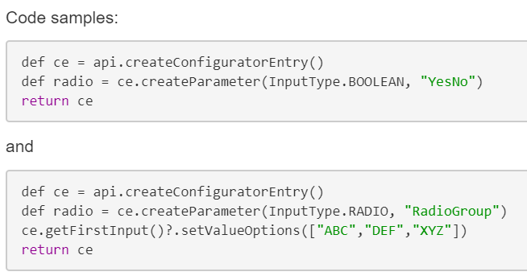
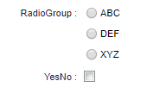
QC Improvements
Configurator Improvements
Automatic configurator refresh on every cell edit can be turned off (you do it manually then)
Done by entry context parameter "noCellRefresh"
Checkboxes and radio buttons can now be used in the configurator

Slide 14
Release Highlights
QC + PM + RM Improvements
PB Improvements
PA Improvements
Workflow Improvements
Other Improvements
AGENDA

Slide 15
PB Improvements
More Control over Price Lists
Selected Price List outputs can be made mandatory (to prevent cases when missing outputs cause integration issues, when e.g. importing approved price lists to SAP)
Enabled by a new configuration option mandatoryPLElements

Slide 16
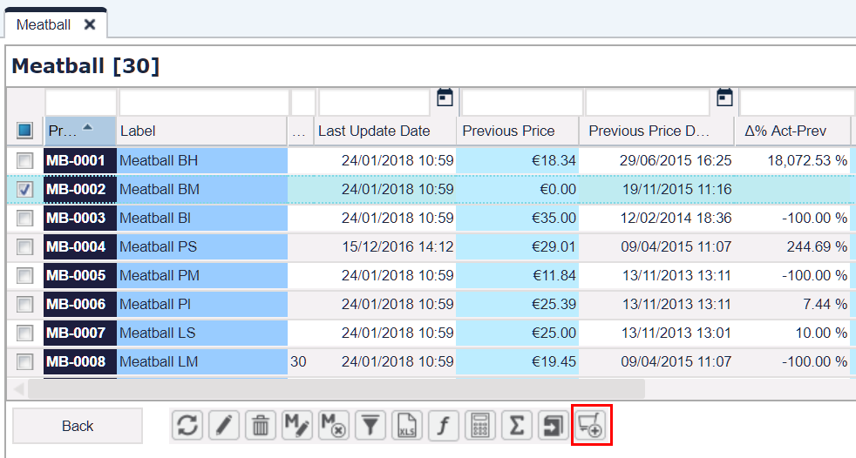
PB Improvements
Faster Adding of Products
New products can be added to a LPG directly in the grid details view
No need to close the details view, add products and open the details again

Slide 17
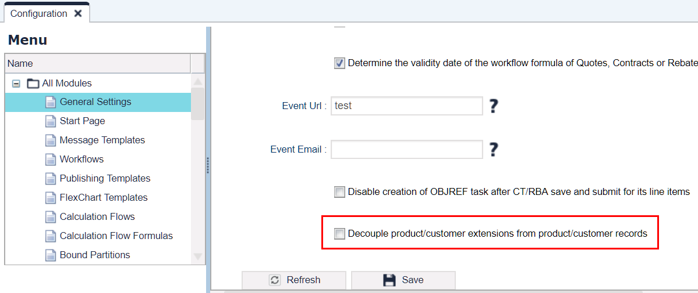
PB Improvements
More Flexibility in Configuration
It is possible to independently edit PX/CX configurations (without regard to Product/Customer records editability)
Editability of a PX/CX record can be taken from the user group editability settings of the corresponding Product/Customer record
Example:
Before: if user could edit product MB-001, he could also edit product extension to MB-001
Now: you can choose that the user can edit only the extension, but not the product

Slide 18
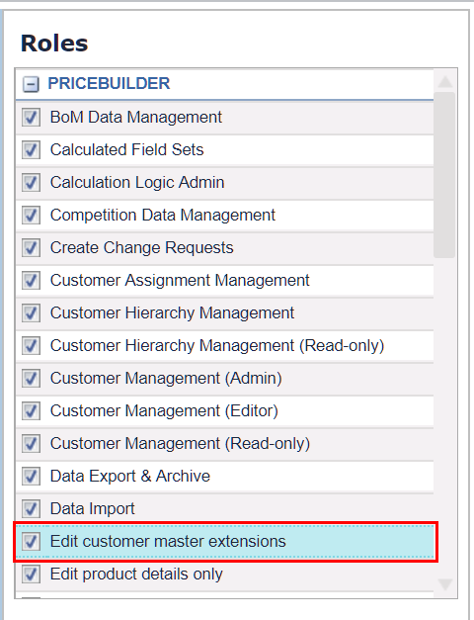
PB Improvements
More Control over CX Editing
New role 'Edit customer master extensions' user
To add, edit and delete Customer Extensions and access (read-only) Customer master details

Slide 19
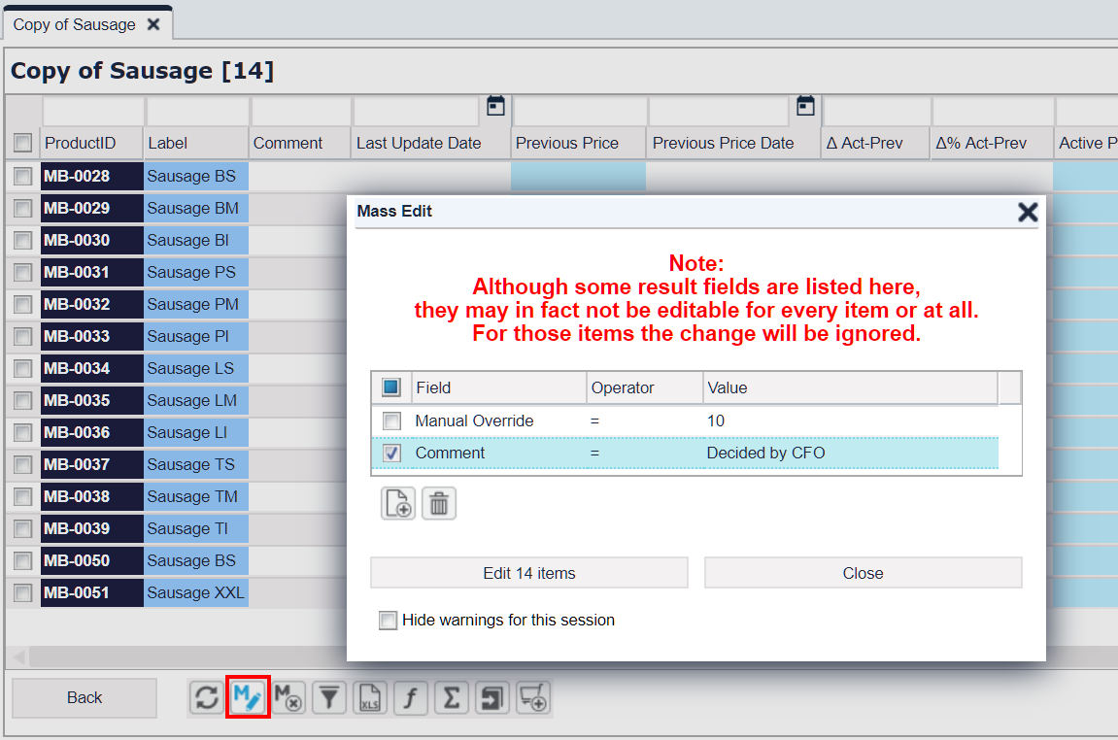
PB Improvements
Faster Work with LPGs
Possible to mass edit multiple overridable Live Price Grids fields

Slide 20
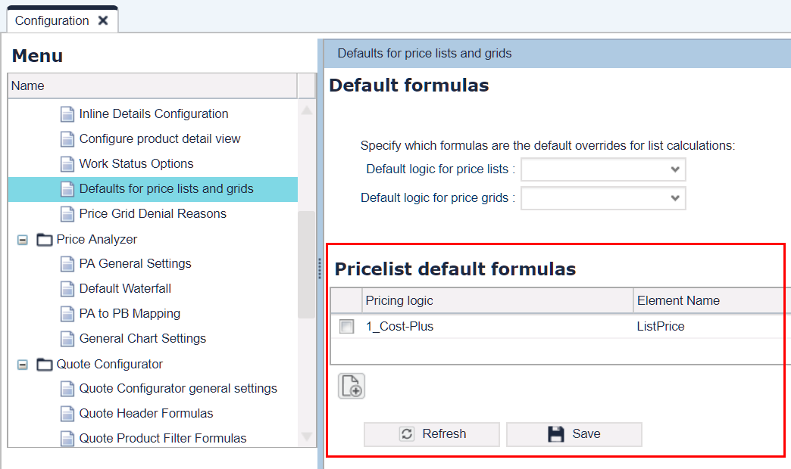
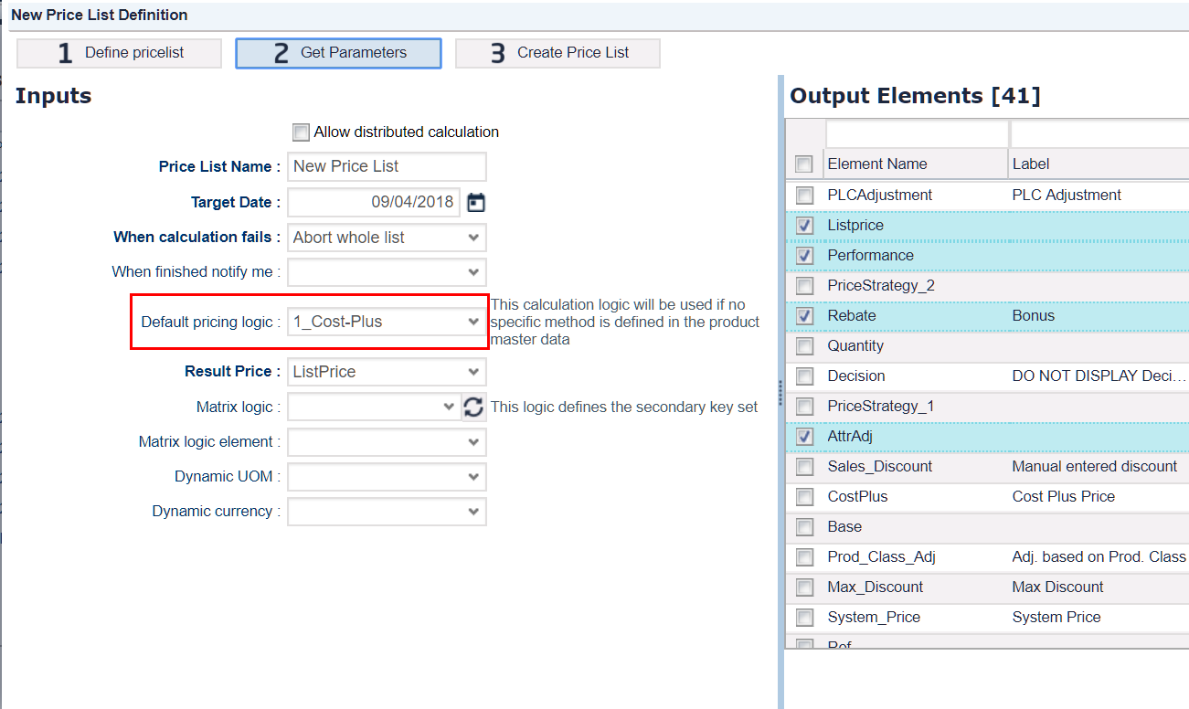
PB Improvements
More Control over PL Creation
It is possible to specify calculation logics that will be available to users for selection when creating a new Price List
You can also specify, which element from the selected logic will be preselected in the Result Price input field

Slide 21
Release Highlights
QC + PM + RM Improvements
PB Improvements
PA Improvements
Workflow Improvements
Other Improvements
AGENDA

Slide 22
PA Improvements
Smoother Integration with ERP
In some ERPs, there are more types of currencies. To accommodate for this need, PriceAnalyzer introduces:
Document Currency (default)
Local Currency
Global Currency
& defined conversions among them

Slide 23
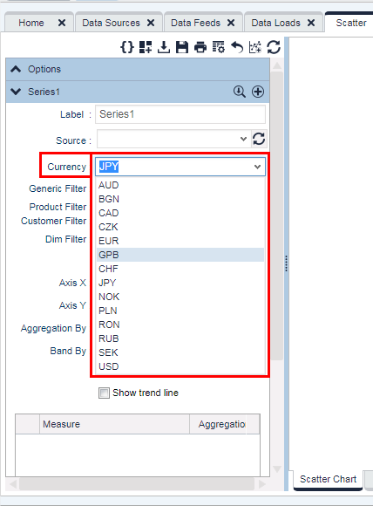
PA Improvements
More Flexibility with Currencies in Charts
There used to be a limit to use maximum 10 currencies in PriceAnalyzer charts or queries
Now you can use all of the implemented currencies

Slide 24
PA Improvements
Charts and Dashboards Improvements
Drill Down and Zoom in charts can be disabled
Useful features for interactive embedded dashboards:
onRowClick() and onCellClick() events are supported in the chart's Data tab (except for Waterfalls)
BarLine charts now support click events on the bars and points
Generic, Aggregation and Dim filters can be displayed for charts embedded in dashboards (and can be editable)

Slide 25
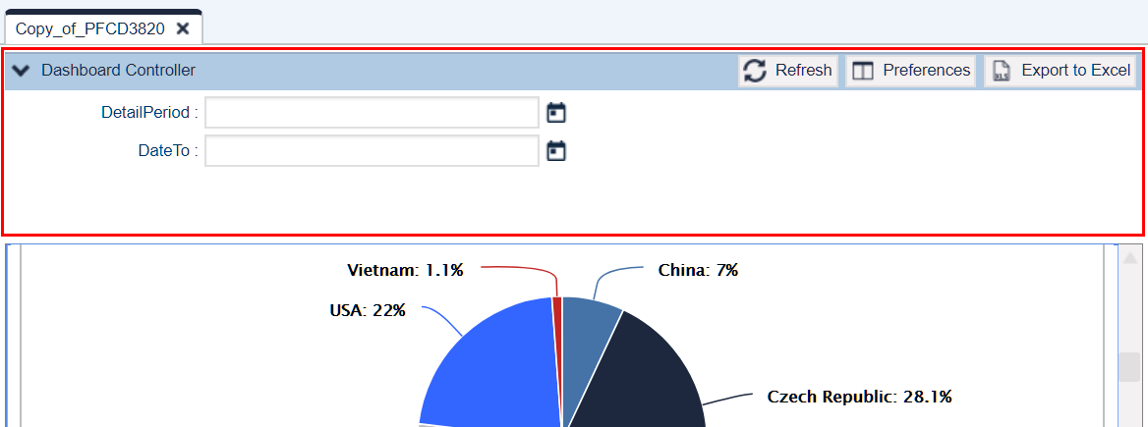
PA Improvements
Dashboard UI Enhanced
Dashboard inputs controller adapts the number of columns according to its width
Possible to show/hide the inputs

Slide 26
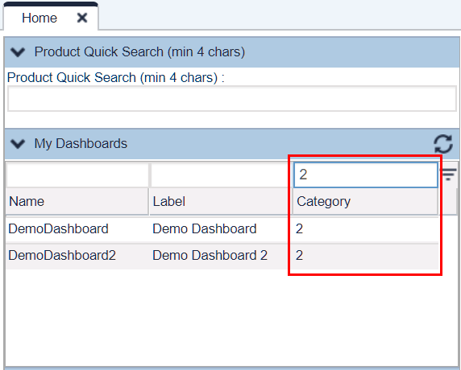
PA Improvements
Easier Work with Dashboards on Home Page
New column called Category – enables to group or filter the dashboard list on the Home page

Slide 27
Release Highlights
QC + PM + RM Improvements
PB Improvements
PA Improvements
Workflow Improvements
Other Improvements
AGENDA

Slide 28
Workflow Improvements
More Flexible Workflow
You can pass through an approval step without any need for approval and still keep a record of the step itself
The workflow logic has access to the previous workflow run and can decide if the previous approvals are still valid regarding the changes (per approval node)
This is useful when a workflow is run for the second time - approvers who approved in the first run can be skipped
To configure it, use:
api.findPreviousApprovableState()
api.findPreviousWorkflowInfo()
ALREADY SATISFIED (workflow step state)
Submitter
Approver 1
Approver 2
Submitter
Approver 1
Approver 2

Slide 29
Workflow Improvements
More Flexible Workflow
You can select a WF step to go to:
Mark (flag) a workflow step
Use this flag in the workflow logic
When the workflow is run next time, it goes to the marked step
Example: Before, if an approver denied the workflow it went back to the creator. Now the approver who denies can select to which workflow step the contract should go back to.
Submitter
Approver 1
Approver 2

Slide 30
Workflow Improvements
More Automation for Quotes
Quotes can be converted to deal automatically during the approval workflow
Use the withAutoConvertToDeal() method in the workflow formula

Slide 31
Release Highlights
QC + PM + RM Improvements
PB Improvements
PA Improvements
Workflow Improvements
Other Improvements
AGENDA

Slide 32
Backend Improvements
Shared Cache
api.global cache is shared now between:
header logic and line item logic
Applies to:
Quotes, Contracts and Rebate Agreements
Pre-phase of header and lines (not between lines and post-phase).

Slide 33
Backend Improvements
More Control for Admins
Email notifications for failed background jobs
Set by the advanced partition property 'sendEmailOnJSTFailure‘
Email is sent to the partition admin email address

Slide 34
Backend Improvements
More Control over Background Jobs
Calculation flow background jobs are cancelled after 30 minutes
To prevent stalled jobs from running indefinitely
Set by cancelProcessingCFInMinutes in pricefx-config.xml

Slide 35
Backend Changes
SSO Session Behavior
After the SSO user session expires, reauthorization is performed automatically
However, the application state is cleared, i.e., all open application tabs are closed, etc.

Slide 36
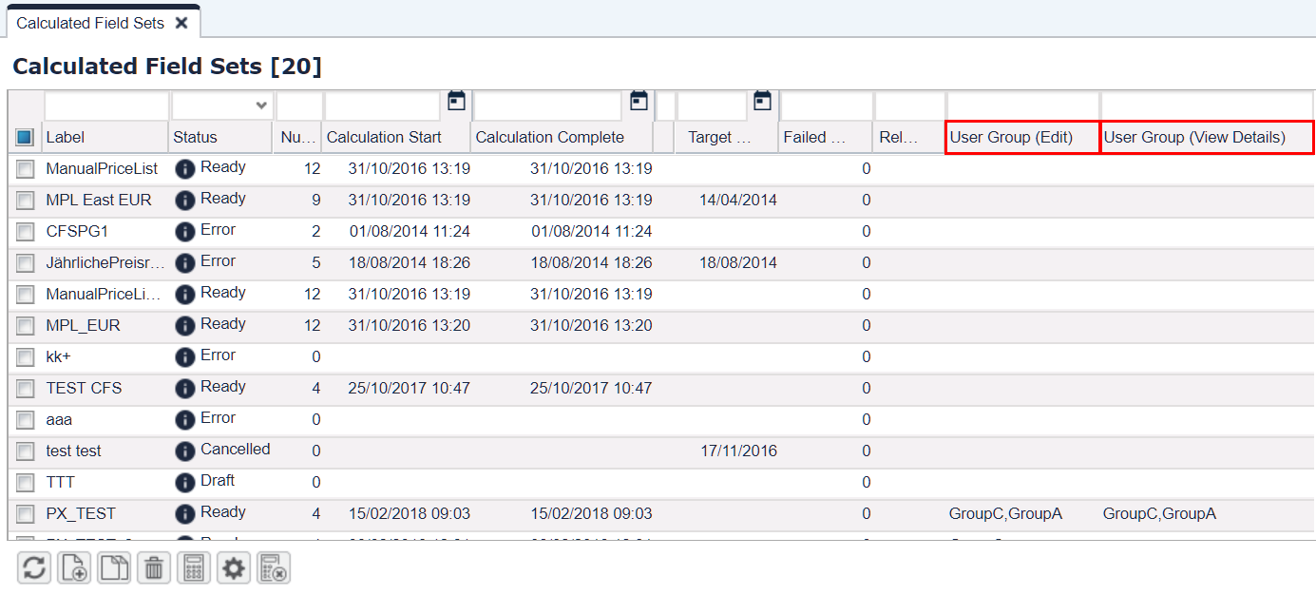
Backend Improvements
More Security for CFS
Running of Calculated Field Sets can be restricted by User Groups

Slide 37
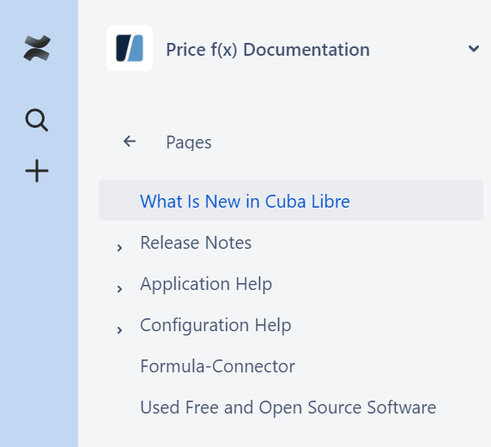
More Information
Price f(x) Universe
https://uni.pricefx.eu
Cuba Libre documentation will be available at the time of the release
How to Make It:
Squeeze the juice of half a lime into a class
Add ice cubes
Pour the rum and cola into the glass
Stir well
Ingredients:
12 cl Cola
5 cl Light rum
1 cl Fresh lime juice

Slide 38
Thank you for
your attention
April, 2018

