Slide 1
Price f(x) – Cosmopolitan Release
December 2017

Slide 2
Release Highlights
QC + RM + PM Improvements
PB Improvements
PA Improvements
Other Improvements
AGENDA

Slide 3
Release Highlights
PriceOptimizer
New module PriceOptimizer
Define pricing segments
Calculate Price Elasticity and/or Willingness to Pay per pricing segment
Define Pricing Strategy/Objectives per pricing segment
Calculate price/deal guidance per pricing segment
Analyze results and suggest changes to segmentation and optimization

Slide 4
Release Highlights
Workflow Improvements
Workflow delegation – with new UI
For end users – self-service delegation in UI
For admins – acting on behalf on any user

Slide 5
Release Highlights
Workflow Improvements
Workflow better accommodates complex company structures
Users who are members of several groups can execute an approval/denial separately and independently for each of the groups

Slide 6
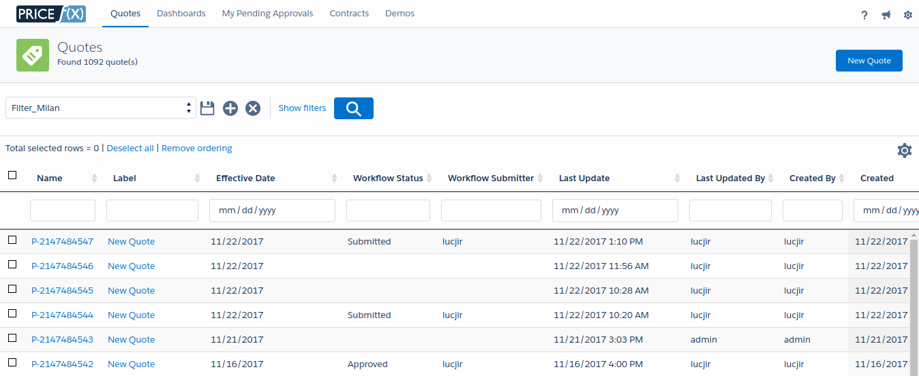
Release Highlights
New UI
New responsive and modern UI
QuoteConfigurator
PromotionManager

Slide 7
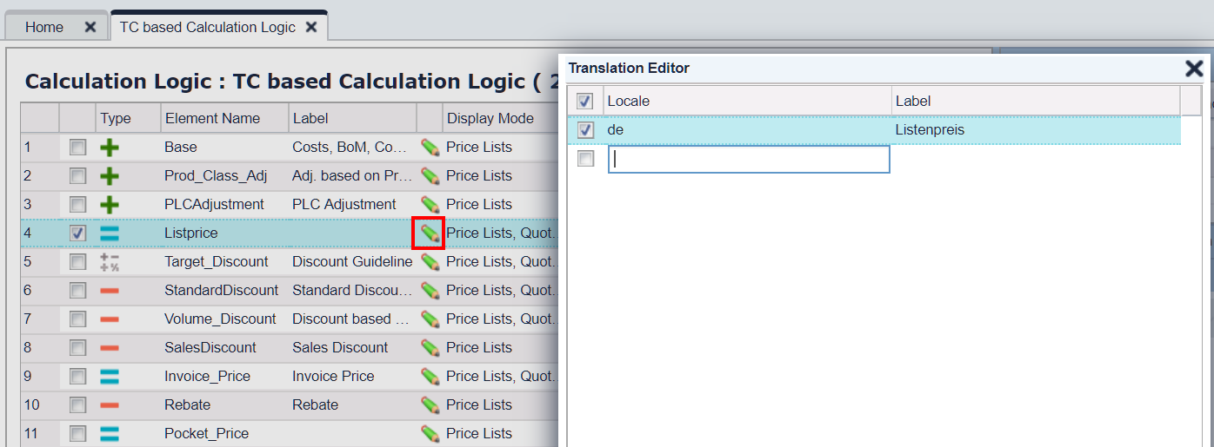
Release Highlights
Improved Localization Support
Easier and more usable setup in multi-national environments –every user can understand the column meanings
Different labels per user's UI language – labels of most columns (which can be renamed) can now also be renamed by locale
In logics there is a new Translation Editor

Slide 8
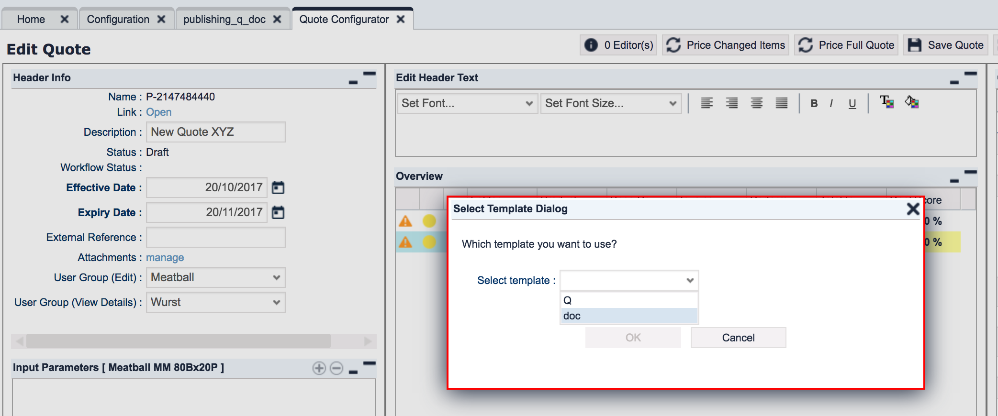
Release Highlights
Better Export to Excel and PDF
Export of quotes etc. to PDF through MS Word template, optionally containing also data from the quote
Multiple templates for Excel export. The selection of a template is up to the end user doing the download.

Slide 9
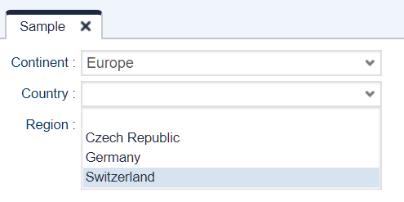
Release Highlights
Inline Configurator
Configurator can also be displayed as dynamic fields directly in the Input Parameters panel. Up to now, the only option was a pop-up window.

Slide 10
Release Highlights
QC + RM + PM Improvements
PB Improvements
PA Improvements
Other Improvements
AGENDA

Slide 11
QC, RM, PM Modules Improvements
Across All Modules
Better control over the Revoke action
Available only to users with the special admin role: Quote Configurator Admin Rebate Agreements Admin Contracts Admin
New confirmation dialog to prevent users from completing this action by mistake

Slide 12
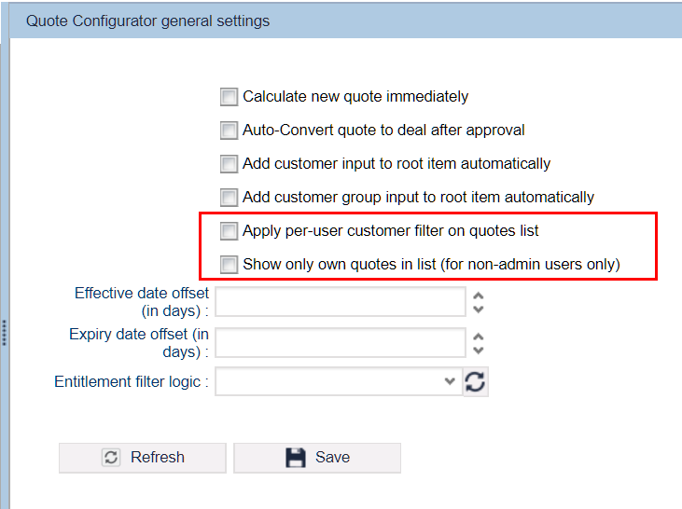
QC Improvements
Quotes visibility
To provide better orientation to sales reps, you can limit the visibility of quotes by:
applying the per user customer filter
showing only objects created by the logged in user

Slide 13
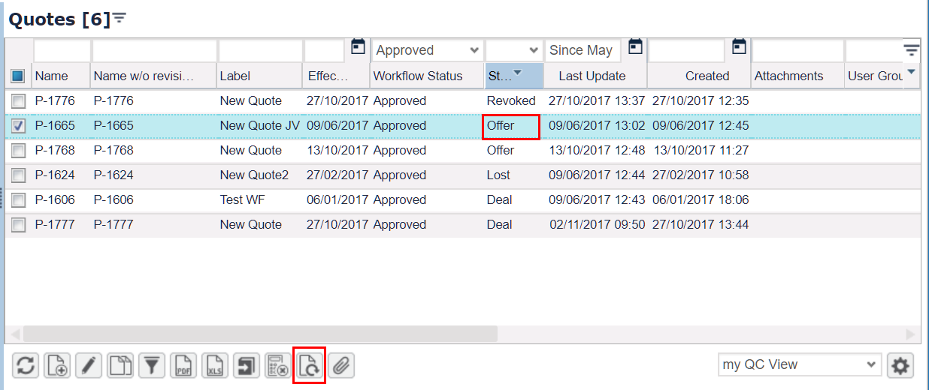
QC Improvements
QC Improvements
It is now possible to create a new revision of an Offer.
Quotes can now have a default Customer Group input (alternatively to a Customer input) on the root level.

Slide 14
QC Improvements
More Convenient Creation of Line Items
Richer formula logic API to create and modify line items and folders
Header logic can now create lines/folders pre-set to a certain value (e.g. default value).

Slide 15
Release Highlights
QC + RM + PM Improvements
PB Improvements
PA Improvements
Other Improvements
AGENDA

Slide 16
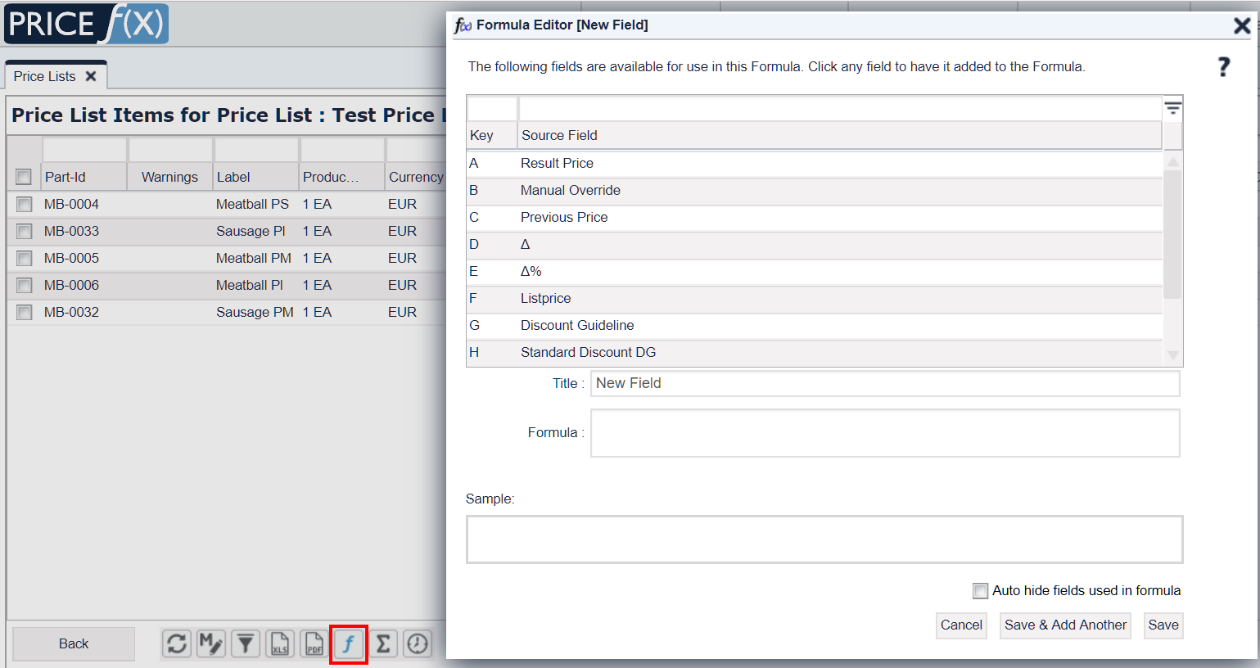
PriceBuilder Improvements
Calculated Fields
Custom field can have mathematical formula – calculates its values from the other fields of the list or grid
Available for:
Price Lists
LPGs
Simulations

Slide 17
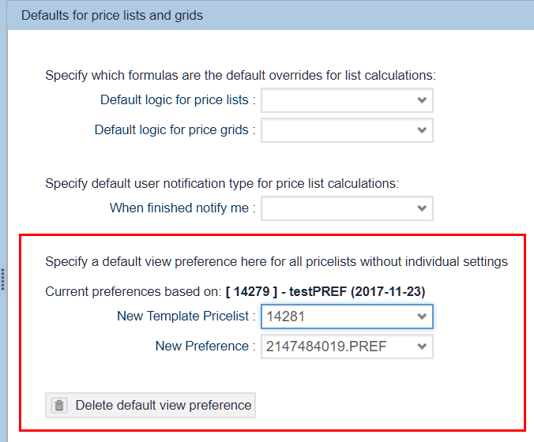
PriceBuilder Improvements
PL View Template
Possible to use specific price list view settings as a template and apply it to other price lists.

Slide 18
Release Highlights
QC + RM + PM Improvements
PB Improvements
PA Improvements
Other Improvements
AGENDA

Slide 19
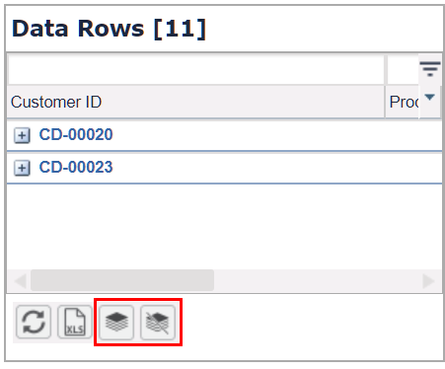
PriceAnalyzer Improvements
Faster Navigation in Data Tables in Charts
New Data Table options: Group (over all defined group-by dimensions) Ungroup completely
Finer grouping in the table header's context menu
Customizations to the chart data table appearance (including grouping state) are preserved when the chart is saved

Slide 20
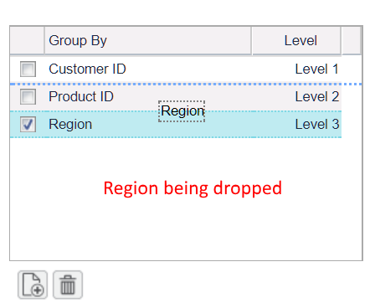
PriceAnalyzer Improvements
More Convenient Definition of Group By
Group By levels in PA data table‘s – now defined in a grid
Easier Editing
Re-ordering by drag & drop

Slide 21
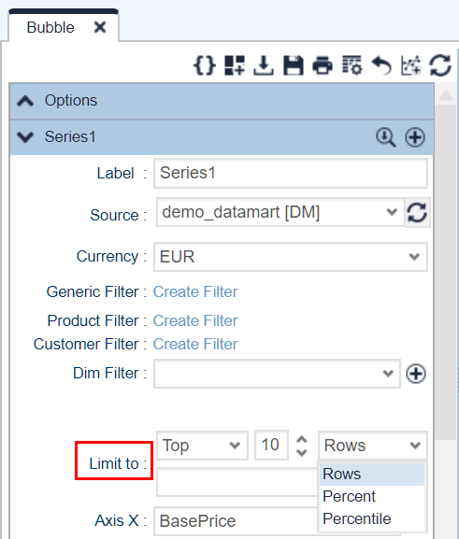
PriceAnalyzer Improvements
Finer Control over Displayed Data
Bubble charts – You can limit the range of displayed data to:
Percentage
Percentile
Number of data rows

Slide 22
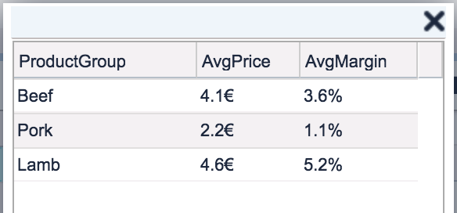
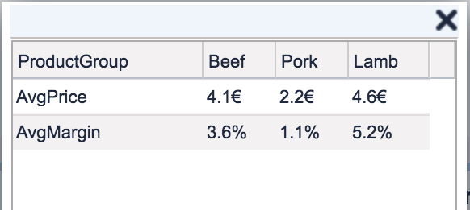
PriceAnalyzer Improvements
More Convenient Data Manipulation
You can transpose data table column headers to rows – just like in Excel, no need to do it manually in PFX
Function ResultMatrix.transpose() in Groovy API

Slide 23
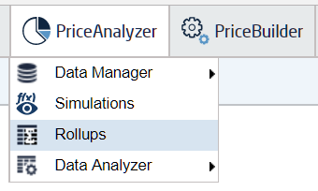
PriceAnalyzer Improvements
Faster Display of PA Data
Rollups enable you to create persistent PA queries
Useful if you repeatedly need to show aggregated data over different time periods, regions, etc. – e.g. in dashboards
Can be used in a formula logic context, wherever now PA queries are used

Slide 24
Release Highlights
QC + RM + PM Improvements
PB Improvements
PA Improvements
Other Improvements
AGENDA

Slide 25
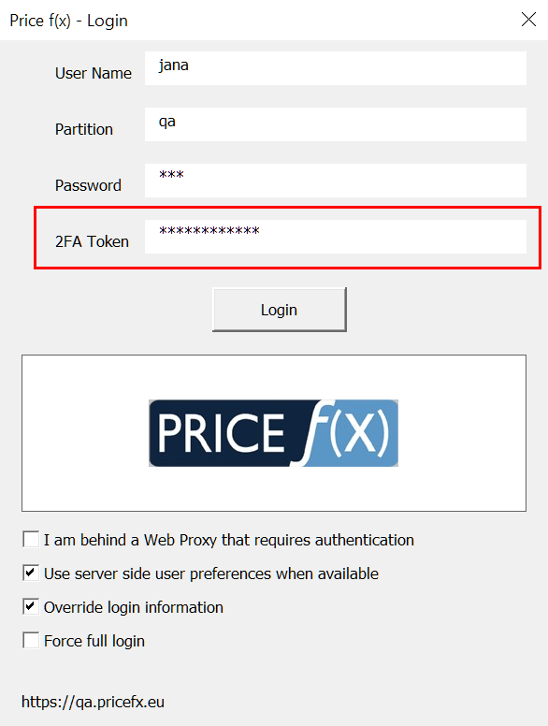
Other Improvements
Safer Access to Excel Client
When logging in the Excel Client, you can now enable two factor authentication

Slide 26
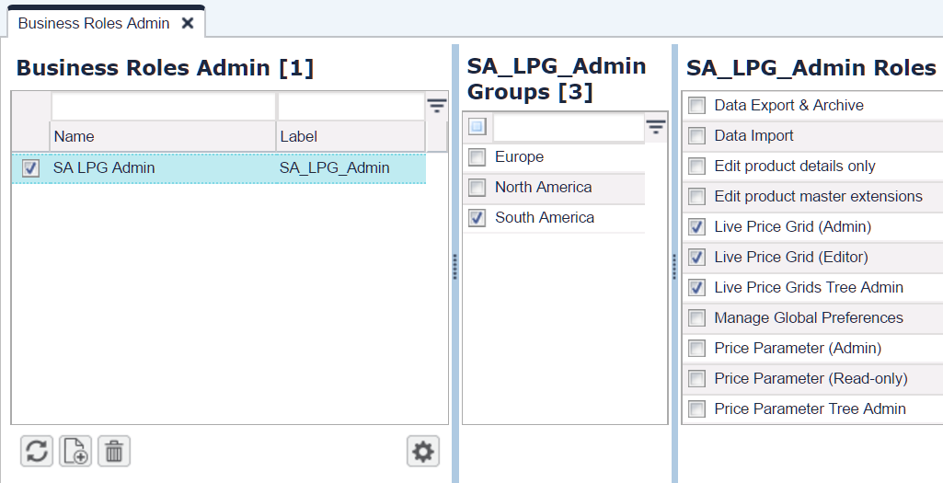
Other Improvements
Easier Control over User Roles and Groups
Business Roles = easy way to create and manage sets of standard roles and groups Business Role can contain several admin roles and user groups – all this can be assigned to one or more users in just one step

Slide 27
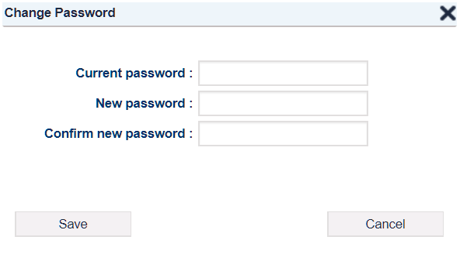
Other Improvements
Safer Password Changes
When updating the password, users must enter the existing one too

Slide 28
Other Improvements
Multiple Groovy Libraries Support
You can create multiple Groovy libraries and use their functions accross the entire application
This way you can create customer-specific functions and each can have its own lifecycle (instead of mixing everything in one library)
Functions are called from calculation logic elements like this:
libs.<formulaName>.<formulaElementName>.<function>

Slide 29
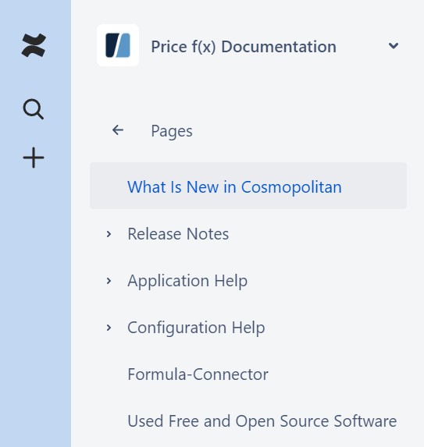
More Information
Price f(x) Universe
https://uni.pricefx.eu
Cosmopolitan documentation will be available at the time of the release

Slide 30
Thank you for
your attention
November, 2017

