Slide 1
Price f(x) – Mojito Release
April 2017

Slide 2
General Improvements
PA Improvements
PB Improvements
QC Improvements
RM + PM Improvements
Workflow Improvements
Other Improvements

Slide 3
General Improvements
PriceOptimizer
New module PriceOptimizer
Define pricing segments
Calculate Price Elasticity and/or Willingness to Pay per pricing segment
Define Pricing Strategy/Objectives per pricing segment
Calculate price/deal guidance per pricing segment
Analyze results and suggest changes to segmentation and optimization

Slide 4
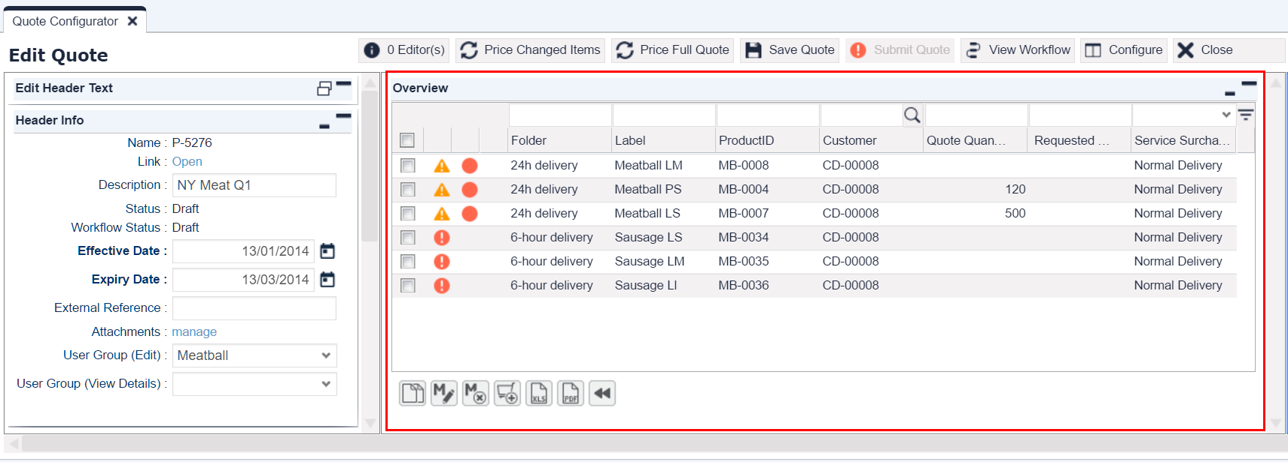
General Improvements
Products in Table View
New view for products in Quotes, Contracts and Rebates:
Hierarchical folders
Line item table –> allows mass add/edit/delete

Slide 5
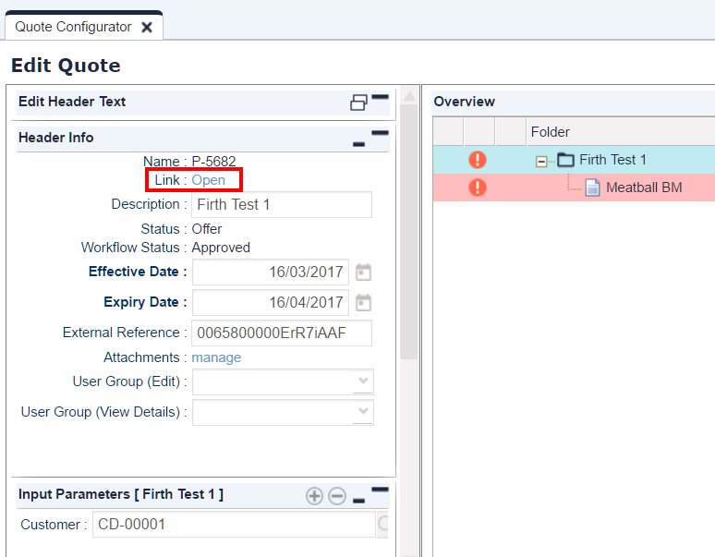
General Improvements
Link to Deals
Direct link to:
Quotes
Agreements
Contracts

Slide 6
General Improvements
PA Improvements
PB Improvements
QC Improvements
RM + PM Improvements
Workflow Improvements
Other Improvements

Slide 7
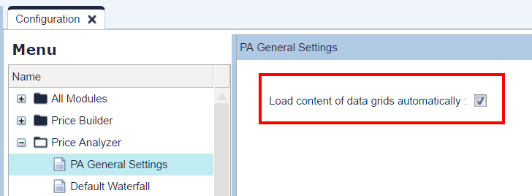
PriceAnalyzer Improvements
Faster Data Load
Data fetching in PA grids:
Automatic or
After user request (can apply filters)

Slide 8
General Improvements
PA Improvements
PB Improvements
QC Improvements
RM + PM Improvements
Workflow Improvements
Other Improvements

Slide 9
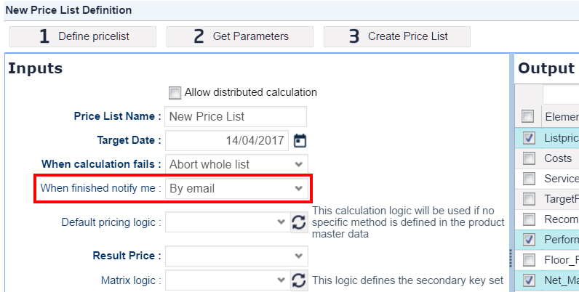
PriceBuilder Improvements
Notification on PL
Email notification when price list calculation finishes

Slide 10
PriceBuilder Improvements
Control of LPG Calculation
You can configure that a full LPG calculation cancels previously queued partial calculations
via property priceGridCancelPartialCalcsOnFullCalc

Slide 11
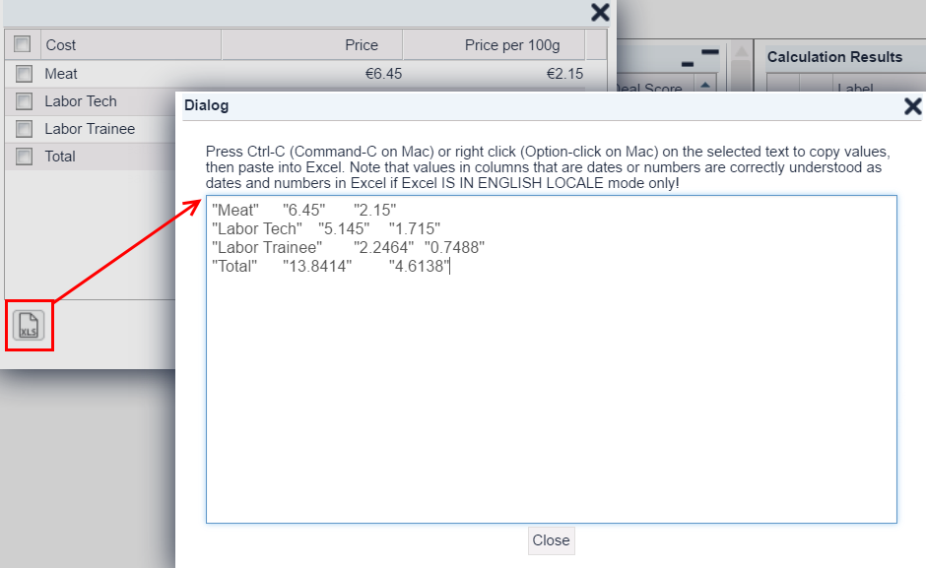
PriceBuilder Improvements
Copy Support
Matrix content download supported via copying to Excel

Slide 12
PriceBuilder Improvements
Unifying PFX Functionality
PDF download also for:
Price Records
Rebate Records
Price List Detail
LPG Detail
XLS download also for:
Quotes
Rebate Agreements
Contracts
Mass Delete also for:
Price Lists
Price Records
Calculated Field Sets work with:
Rebate Records

Slide 13
PriceBuilder Improvements
Expanding Configuration Options
Business Key can be defined as:
Product SKU (in Product Extension configuration)
Customer ID (in Customer Extension configuration)
Audit Logs cover also major configuration settings

Slide 14
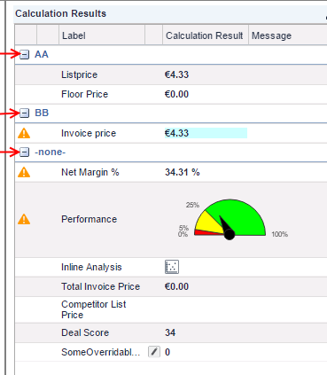
PriceBuilder Improvements
Logic Enhancements
Grouping of calculation results

Slide 15
General Improvements
PA Improvements
PB Improvements
QC Improvements
RM + PM Improvements
Workflow Improvements
Other Improvements

Slide 16
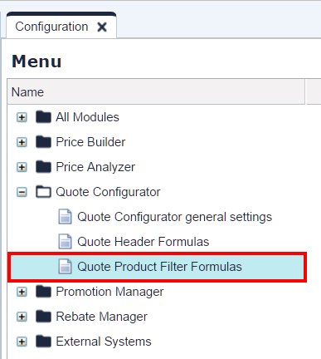
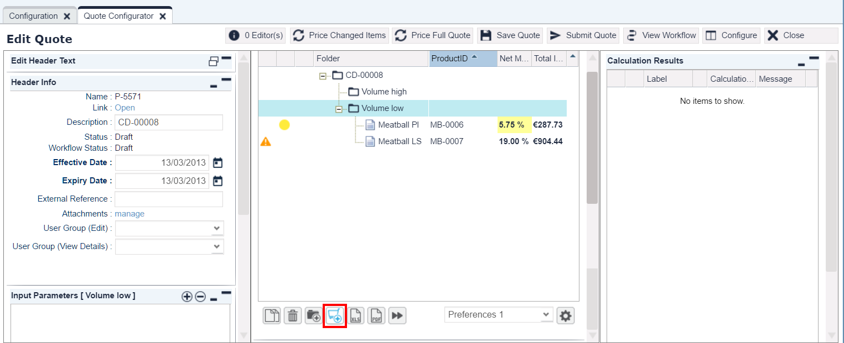
QuoteConfigurator Improvements
Product Pre-filtering
Filter on product selection – based on logic
applied when opening Product Picker

Slide 17
General Improvements
PA Improvements
PB Improvements
QC Improvements
RM + PM Improvements
Workflow Improvements
Other Improvements

Slide 18
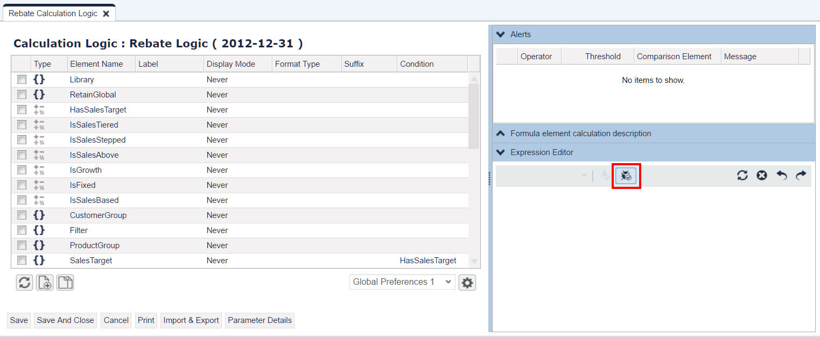
RebateManager + PromotionManager Improvements
Logic Testing During Development
Test Drive functionality also available for:
Rebate calculation logic
Contract calculation logic

Slide 19
General Improvements
PA Improvements
PB Improvements
QC Improvements
RM + PM Improvements
Workflow Improvements
Other Improvements

Slide 20
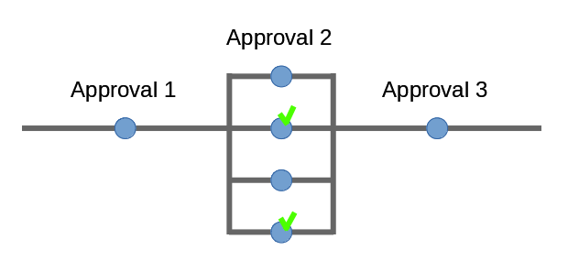
Workflow Improvements
Simple Parallel Workflow
Up to now: all approvals had to run in a sequence
Now:
Each approval step can have more approvers
You can define that if e.g. 2 out of 4 approve, the step is considered approved

Slide 21
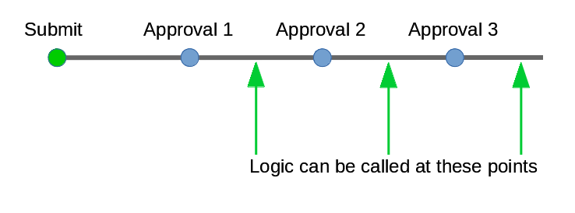
Workflow Improvements
Post Step Logic Formula
Up to now: workflow logic was evaluated just once, during Submit
Now: you can configure a logic to be triggered after any approved step

Slide 22
Workflow Improvements
Better Workflow Selection
More Active workflows – valid formula is picked up based on:
Document's effective date or
Submit date

Slide 23
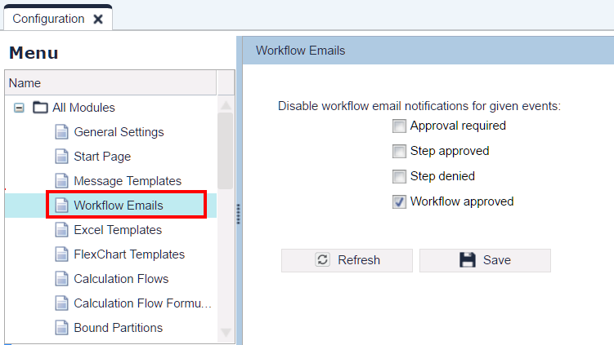
Workflow Improvements
Control over Notifications
You can decide for which workflow events notification emails are sent

Slide 24
Workflow Improvements
Other Improvements
Adding extra workflow steps can be restricted to Workflow Admins only
Workflow emails can access more data from the object which triggered sending the message
Method api.findWorkflowInfo returns data for denied and withdrawn steps too
Workflow element's timeout period can be overriden

Slide 25
General Improvements
PA Improvements
PB Improvements
QC Improvements
RM + PM Improvements
Workflow Improvements
Other Improvements

Slide 26
Admin Improvements
User Role Restrictions
Roles that can modify users/roles can no longer extend their own privileges
All roles in the Admin section will be assignable when the assigning user:
Is General Admin
Has user modifying permissions (e.g. User Admin or Support )
Has the admin role that he wants to assign (e.g. 'Product master admin' can grant 'Product master admin' to others)

Slide 27
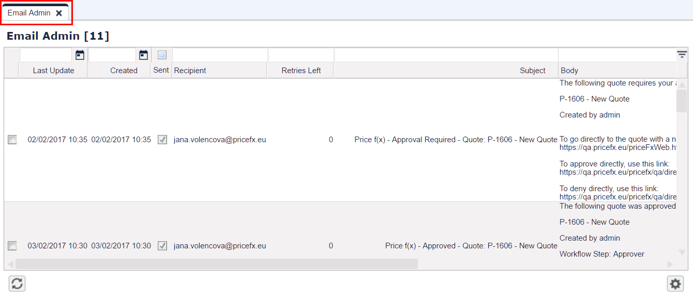
Admin Improvements
Email Monitoring
New Email Admin section in Configuration
To monitor the progress of email tasks being processed by the application.

Slide 28
Backend Improvements
Temporary In-memory Database
New temporary in-memory database – filled and consumed by the formula logic
–> Improves ease of use and performance of a logic that uses data repeatedly from multiple data objects

Slide 29
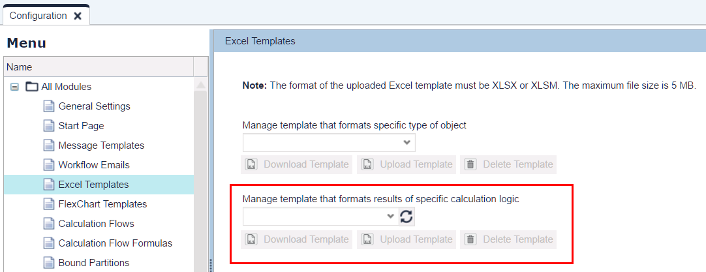
Backend Improvements
Logic Template
Default XLS template for logic
Simple results are in the main data sheet as name/value
More complex results (list of maps or resultMatrix) are in their own sheet

Slide 30
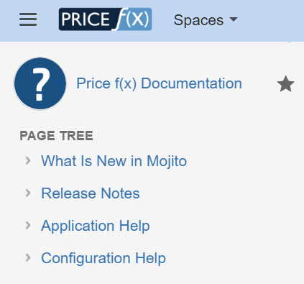
More Information
Price f(x) Universe
https://uni.pricefx.eu
Mojito documentation will be available at the time of the release

