Slide 1
Price f(x) – Mai Tai Release
WebEx 15th of November 2016

Slide 2
General Improvements
PA Improvements
PB Improvements
QC Improvements
RM Improvements
Other Improvements

Slide 3
General Improvements
New Look
New icons and new colors – to stay fresh and modern

Slide 4
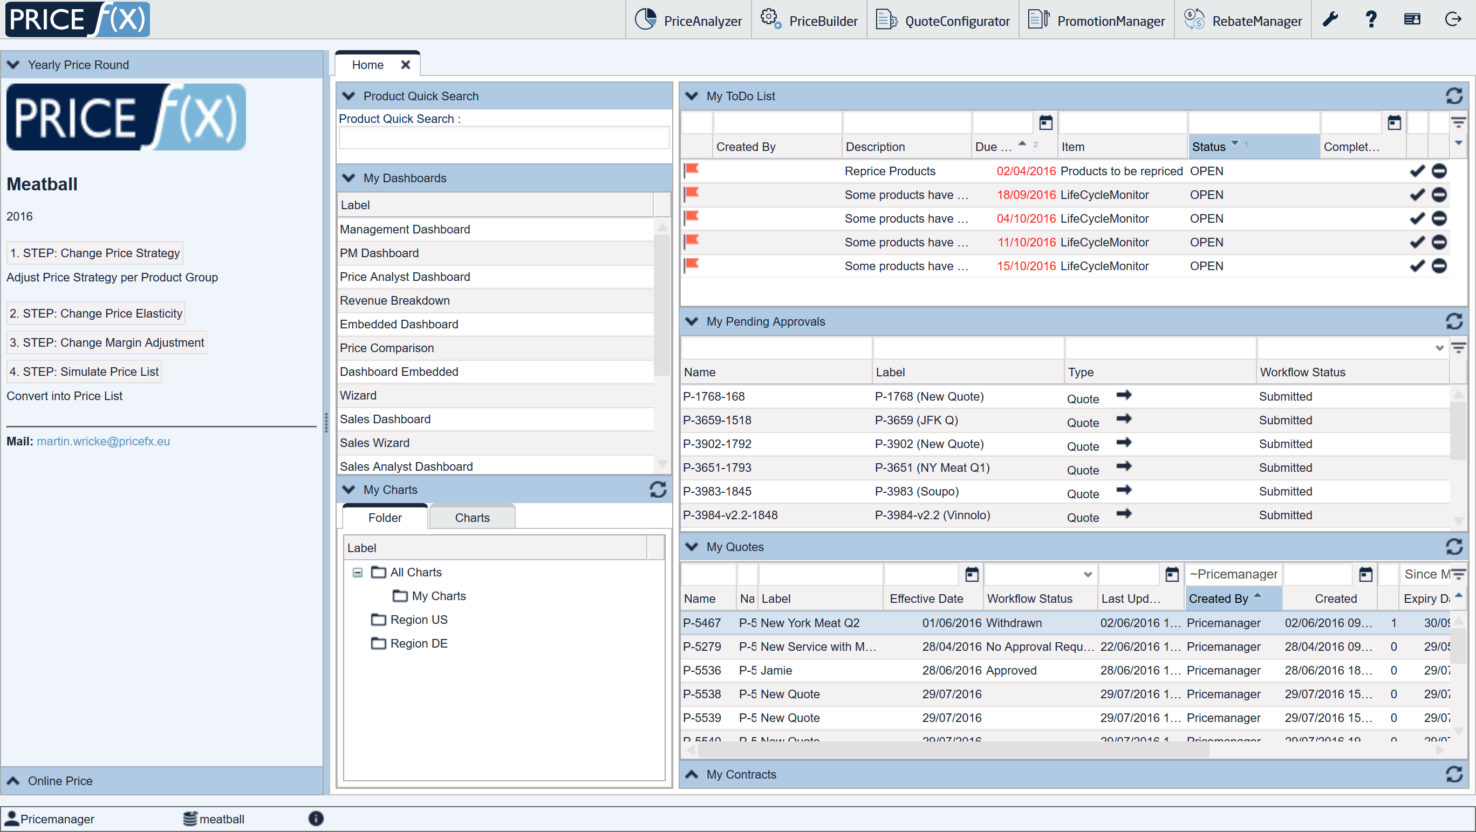
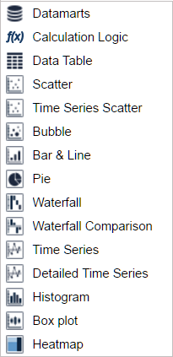
General Improvements
New Look
New icons and new colors – to stay fresh and modern

Slide 5
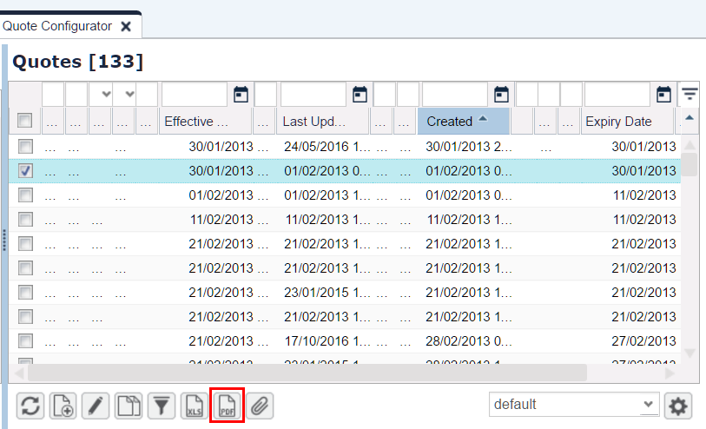
General Improvements
PDF Publishing
PDF export for:
Quotes
Price Lists
Live Price Grids
Contracts
Rebate Agreements

Slide 6
General Improvements
PDF Publishing
Price f(x) uses a third party service – CloudConvert
If you want to use the service (no costs for you) you need to accept the T&C.
To produce PDF files out of quotes, rebate agreements, contracts, etc. CloudConvert does conversions from XLSX to PDF through MS Excel
The final layout is exactly the same as when you print the document locally in your MS Office.
PDF Publishing is available for Quotes, Rebate Agreements, Contracts and Price Lists

Slide 7
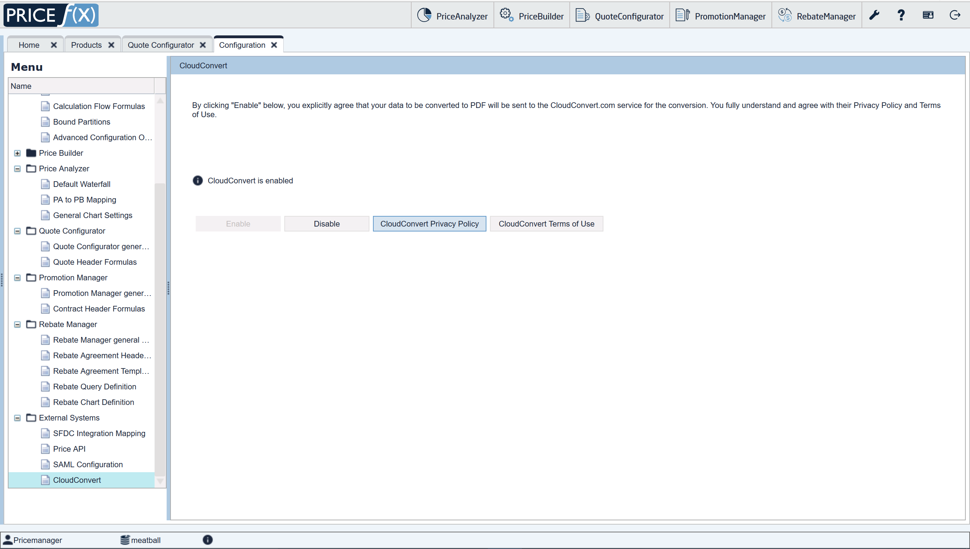
General Improvements
PDF Publishing

Slide 8
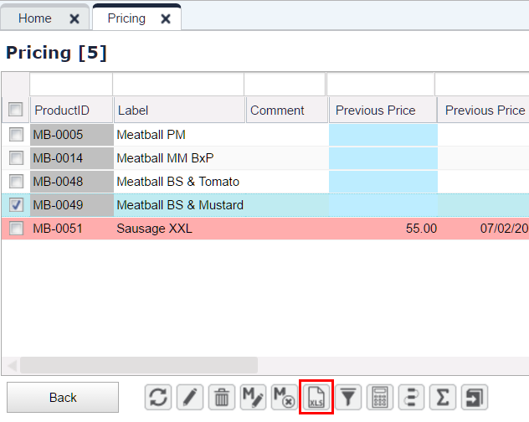
General Improvements
Excel Client for LPG
Supports manual price overrides in XLS

Slide 9
General Improvements
PA Improvements
PB Improvements
QC Improvements
RM Improvements
Other Improvements

Slide 10
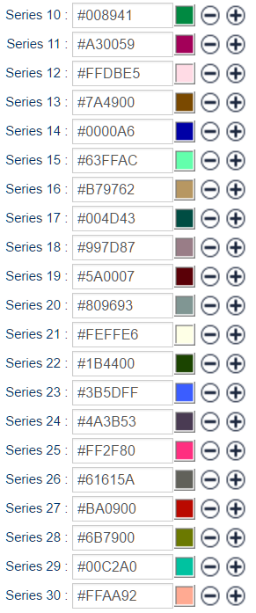
PriceAnalyzer Improvements
Charts Easier to Read
New set of 30 colors – easier to distinguish from each other

Slide 11
PriceAnalyzer Improvements
New Datamart Viewer
Clearer navigation for selecting what you want to view – either Datamart or related Data Sources

Slide 12
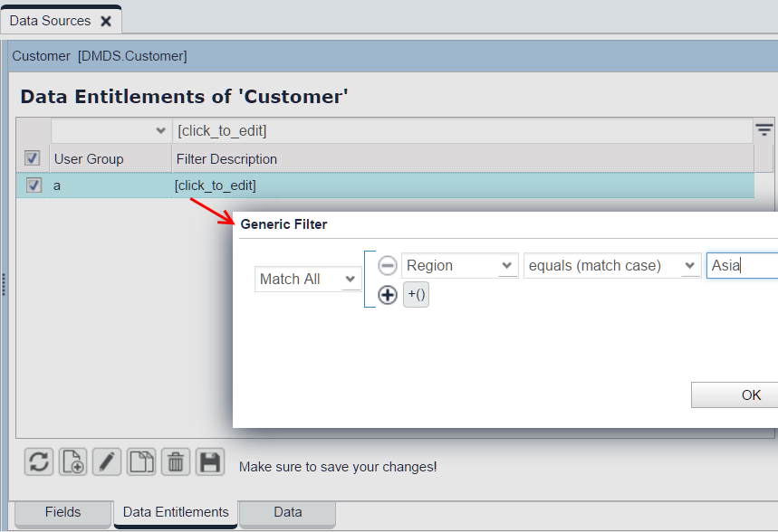
PriceAnalyzer Improvements
Data Source Entitlement
Possible to set up entitlement for Data Sources
Kept in Datamart too

Slide 13
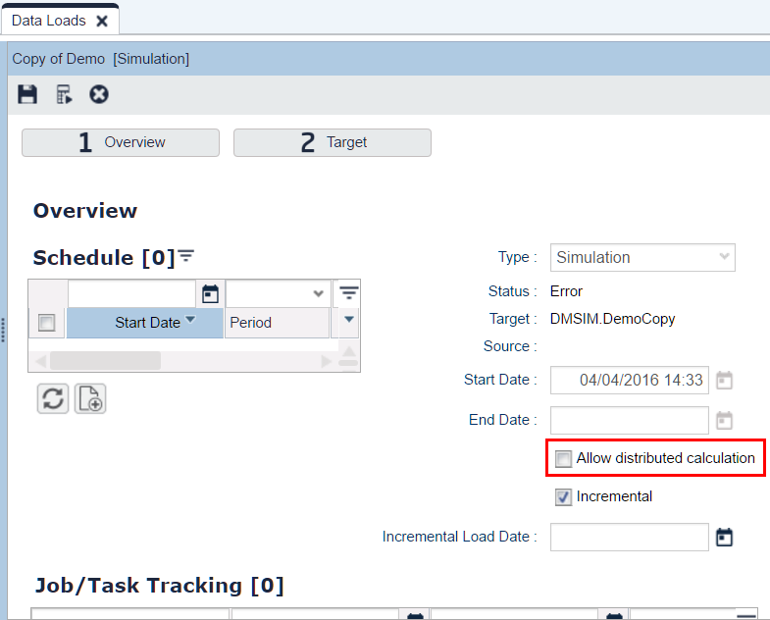
PriceAnalyzer Improvements
Faster Executions of Simulations
Simulations can run in distributed mode
processing of individual Datamart rows is split among several nodes

Slide 14
General Improvements
PA Improvements
PB Improvements
QC Improvements
RM Improvements
Other Improvements

Slide 15
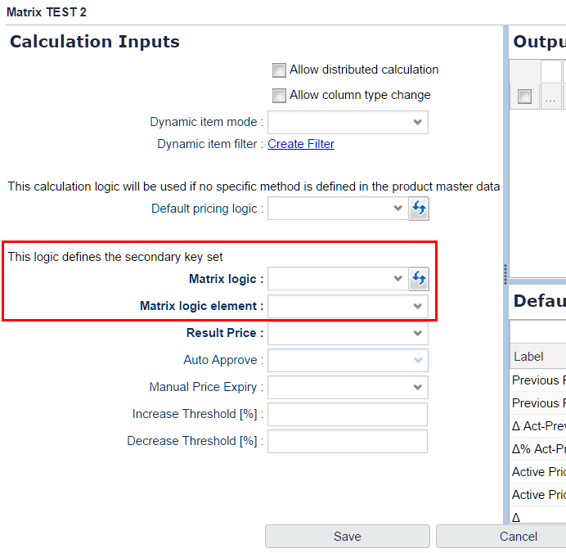
PriceBuilder Improvements
Matrix Support for LPG
Possibility to define a Matrix Logic which creates secondary key(s) for each product in the LPG
Lines to appear/disappear in the LPG as the product membership and/or the secondary key(s) changes.

Slide 16
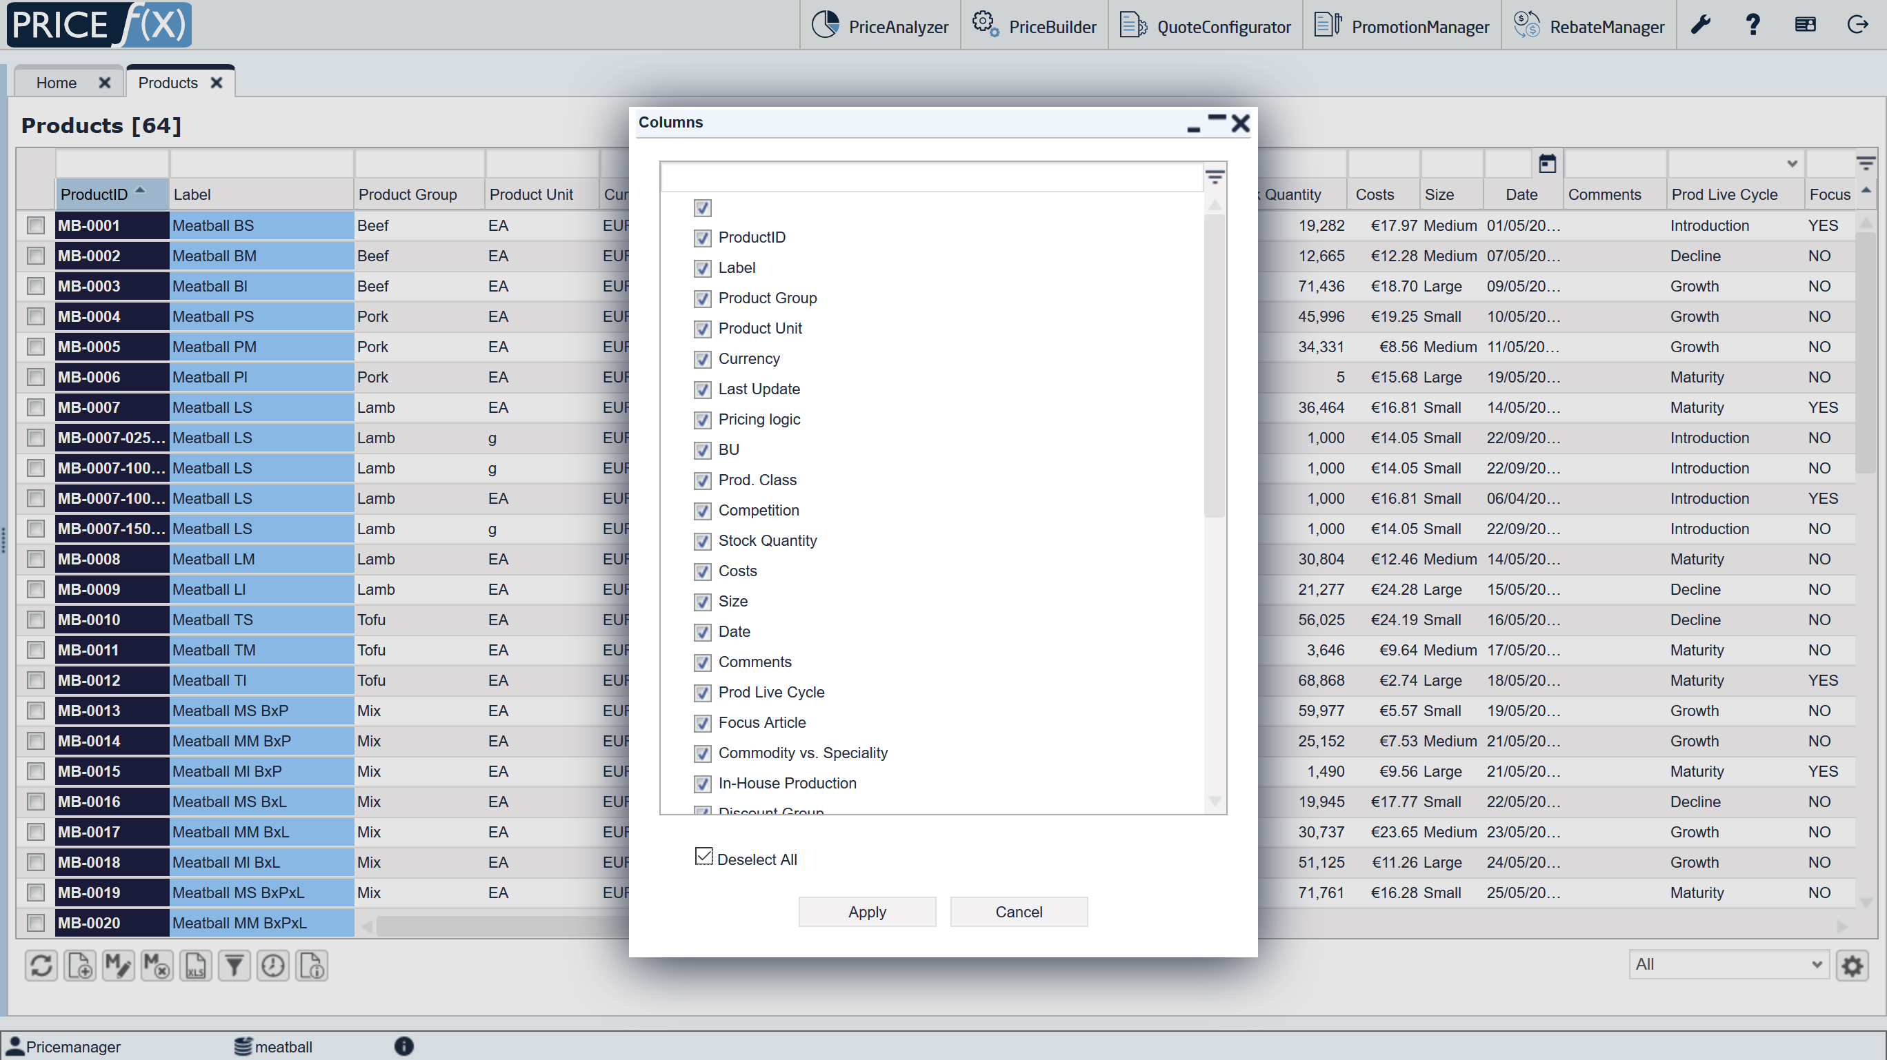
PriceBuilder Improvements
UI Improvements
"Columns" popup window – select/deselect all items with a single click

Slide 17
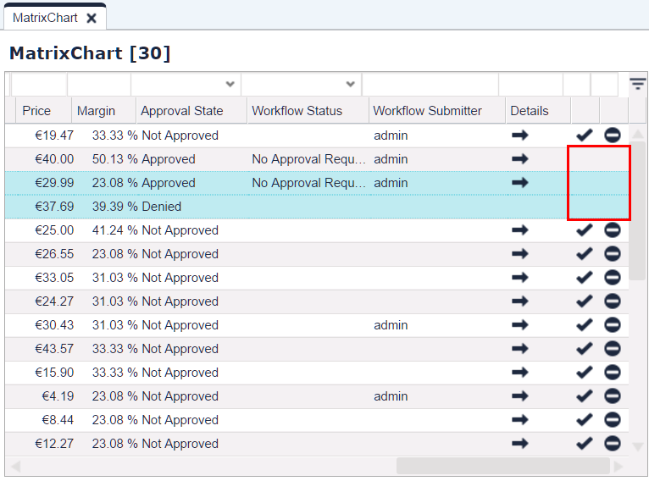
PriceBuilder Improvements
UI Improvements
After you click the approve/deny options inside a LPG row, the icons disappear - to show that the action was done

Slide 18
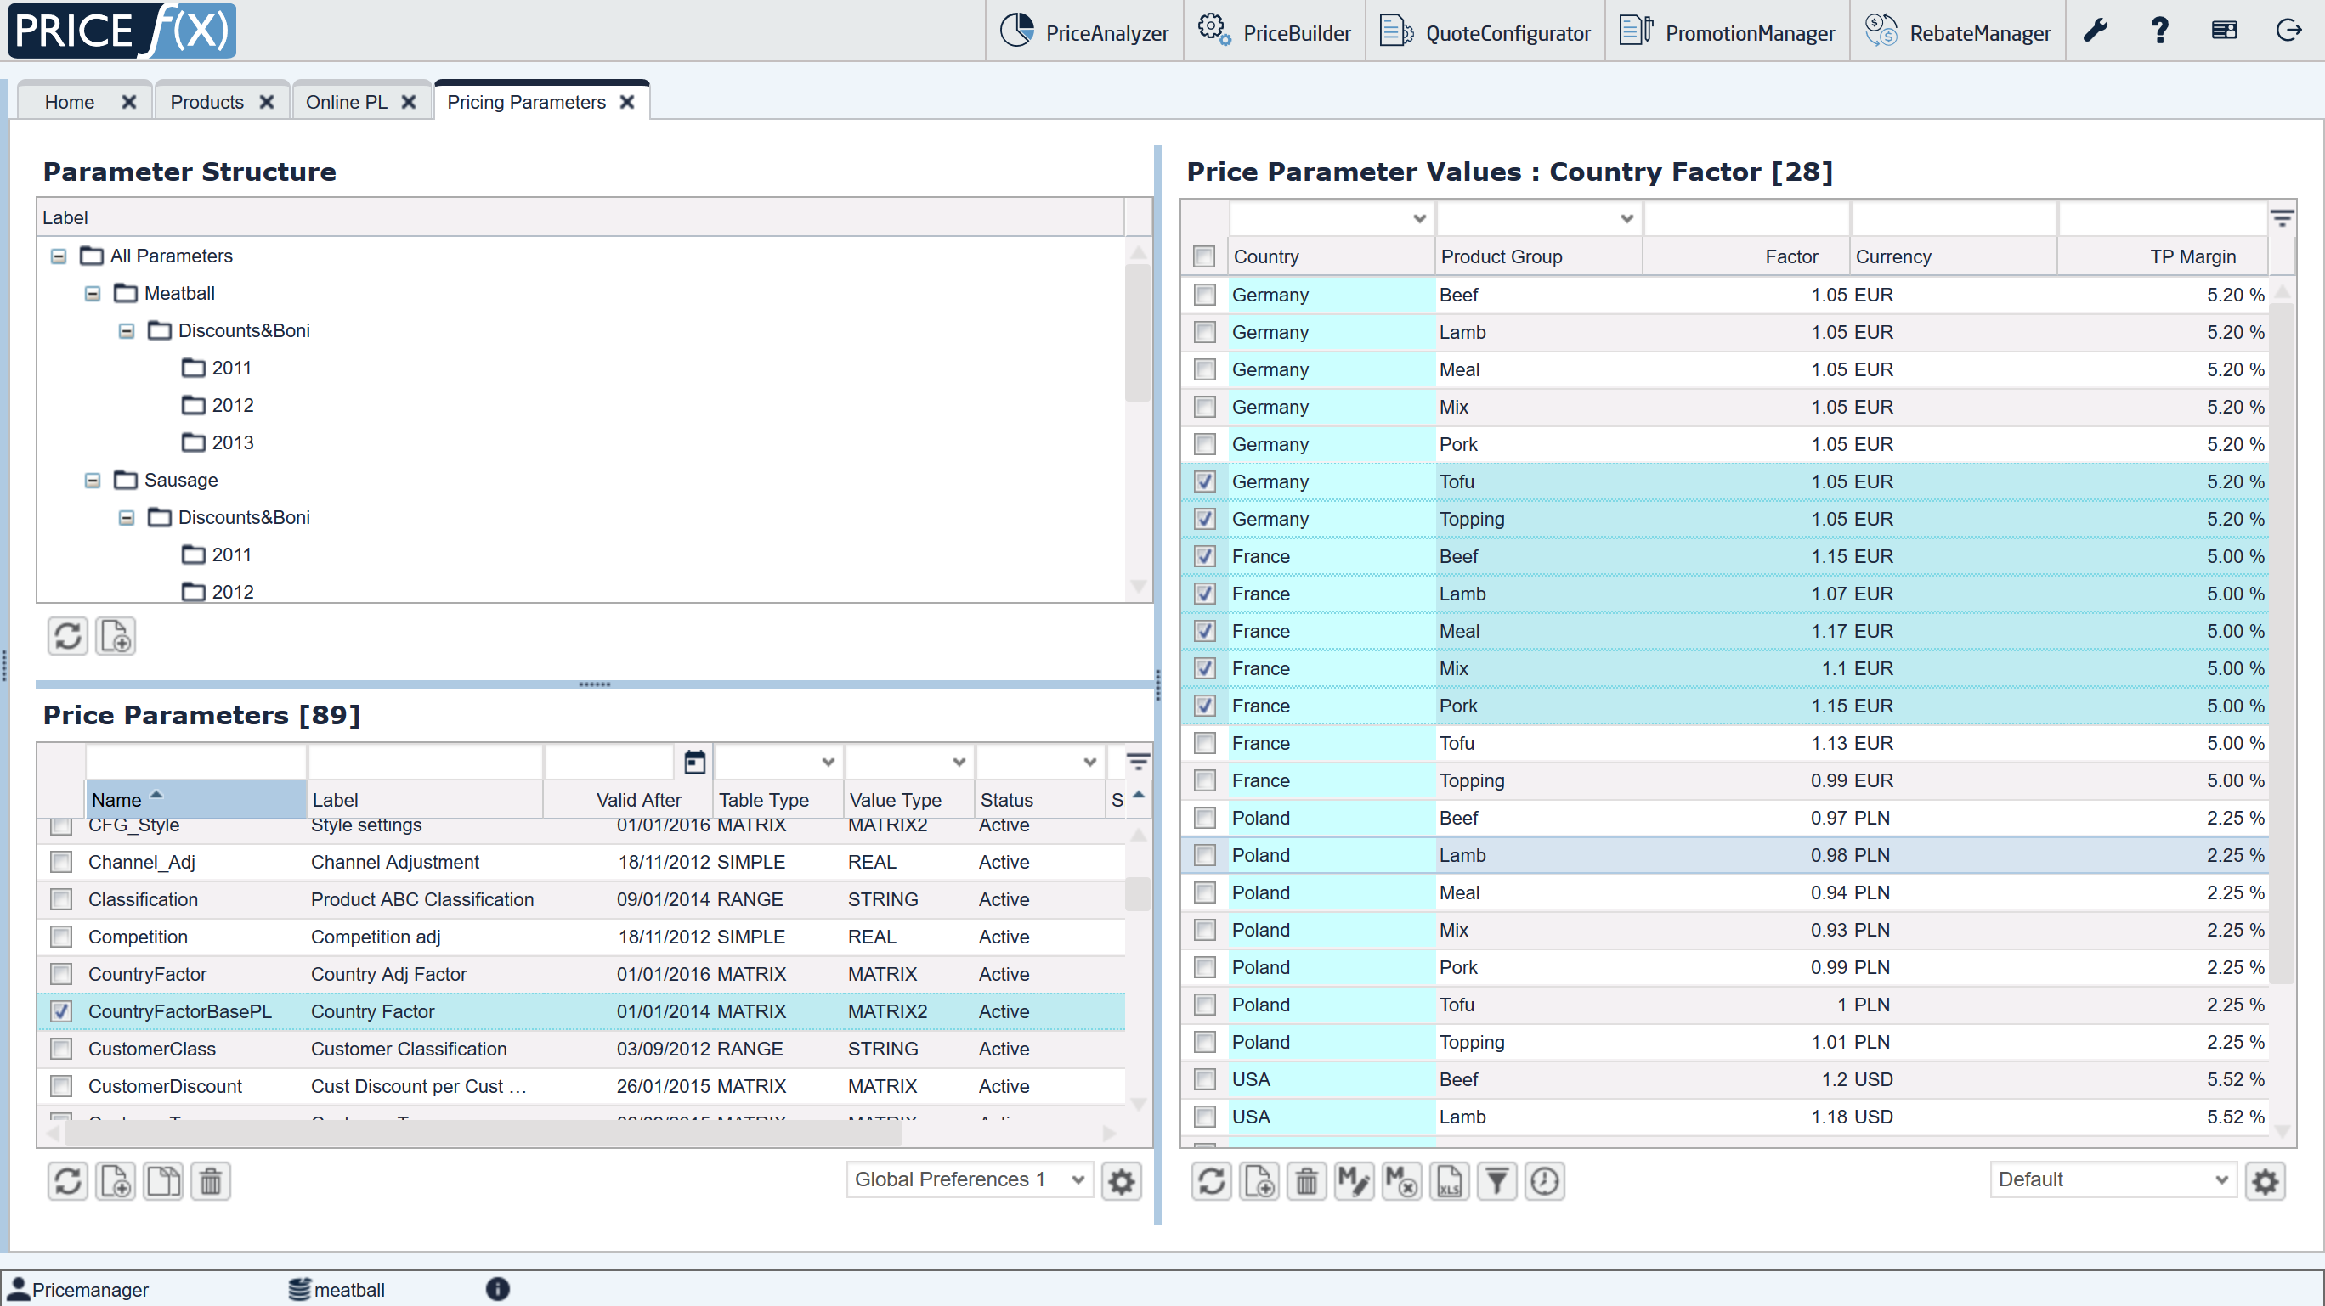
PriceBuilder Improvements
UI Improvements
Select row by clicking anywhere in the row. With Shift + Ctrl you can select multiple rows

Slide 19
PriceBuilder Improvements
More Flexibility in Configurators
New API call – allows returning multiple entries from a Groovy element
The Meta Configurator is a framework which leverages the Configurator functionality
A non-programmer can create his own dynamic Configurators
Generic configuration logic for configurator
Parameterization of all Configurations
Configuration options and settings in Pricing Parameter Tables

Slide 20
PriceBuilder Improvements
More Flexibility in Configurators

Slide 21
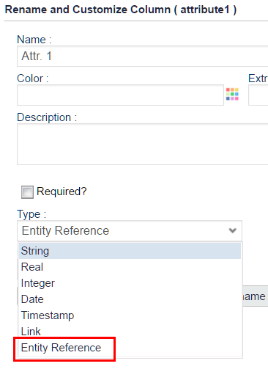
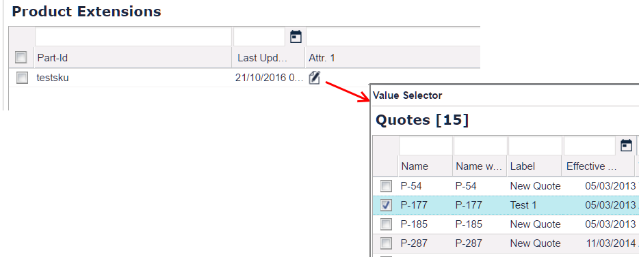
PriceBuilder Improvements
Getting Round and Using the App
Possible to create links to objects within PFX

Slide 22
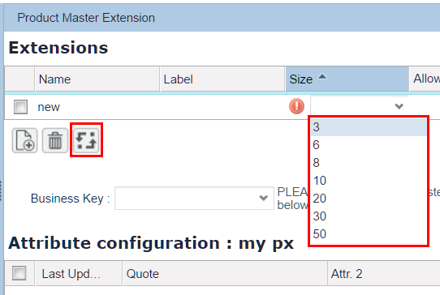
PriceBuilder Improvements
Better Performance & Security
New sizes of product extensions tables: 3, 6, 8, 10, 20, 30 and 50 attributes (instead of just 30)
If you change from e.g. 10 to 6 attributes, mapping will be displayed

Slide 23
General Improvements
PA Improvements
PB Improvements
QC Improvements
RM Improvements
Other Improvements

Slide 24
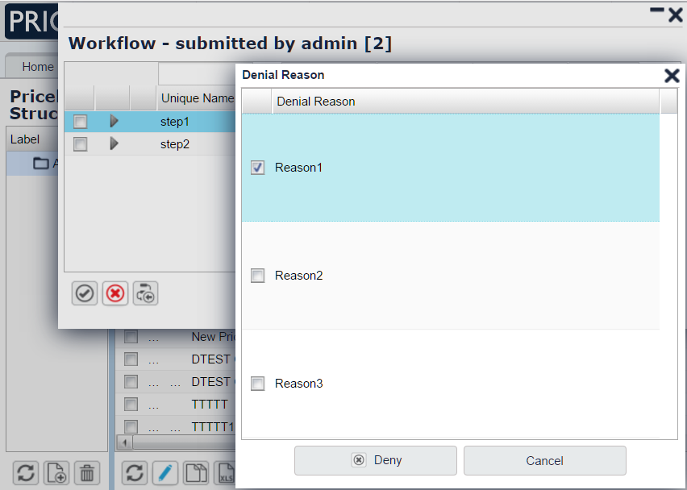
QuoteConfigurator Improvements
Specifying Denial Reasons in Workflows and LPG
Configurable denial & approval reasons
Free text field or predefined options
Can be optional or mandatory
Same functionality also for denials in LPG – reasons can be defined in Configuration

Slide 25
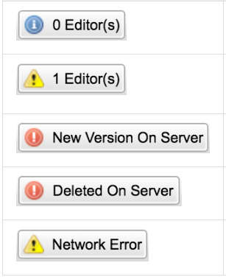
QuoteConfigurator Improvements
Notifications on Concurrent Editing
During concurrent editing – info buttons displayed
When saving – new options to:
View the latest version
Discard their changes

Slide 26
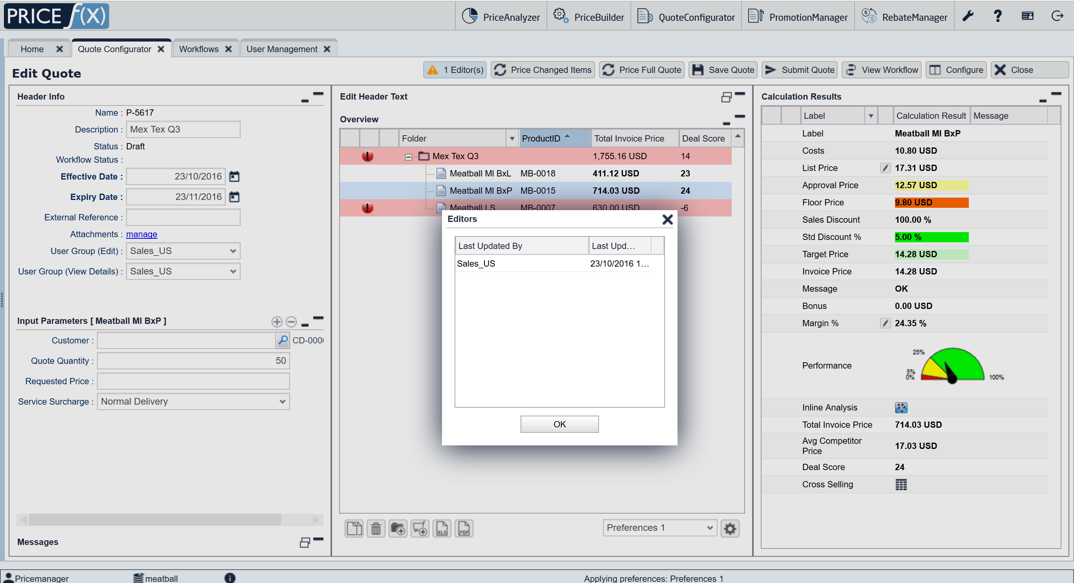
QuoteConfigurator Improvements
Notifications on Concurrent Editing

Slide 27
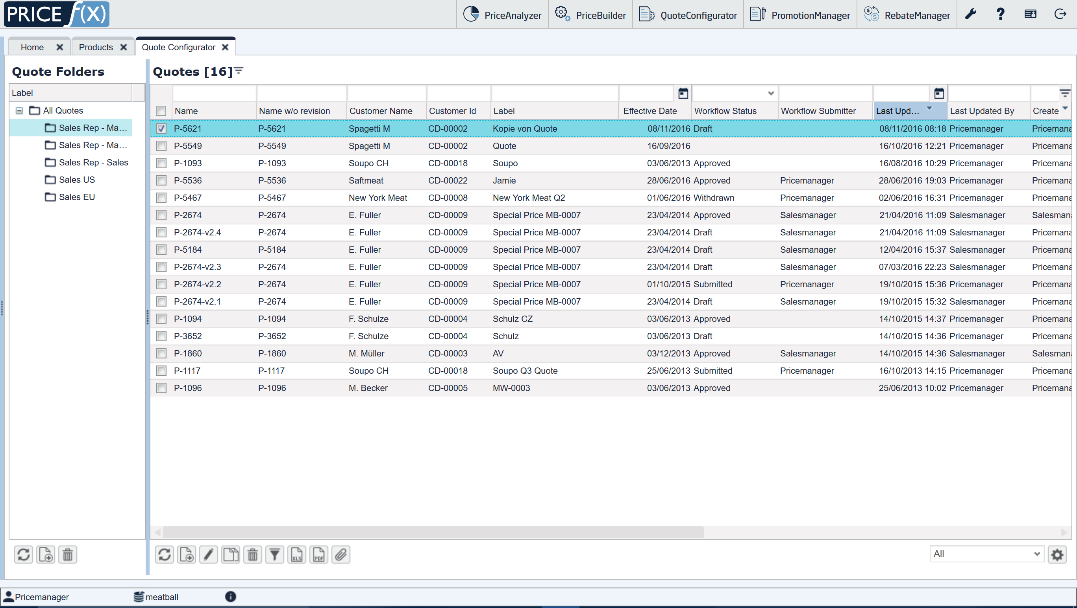
QuoteConfigurator Improvements
Getting Round and Using the App
Quote copies have "Copy of“ in the label

Slide 28
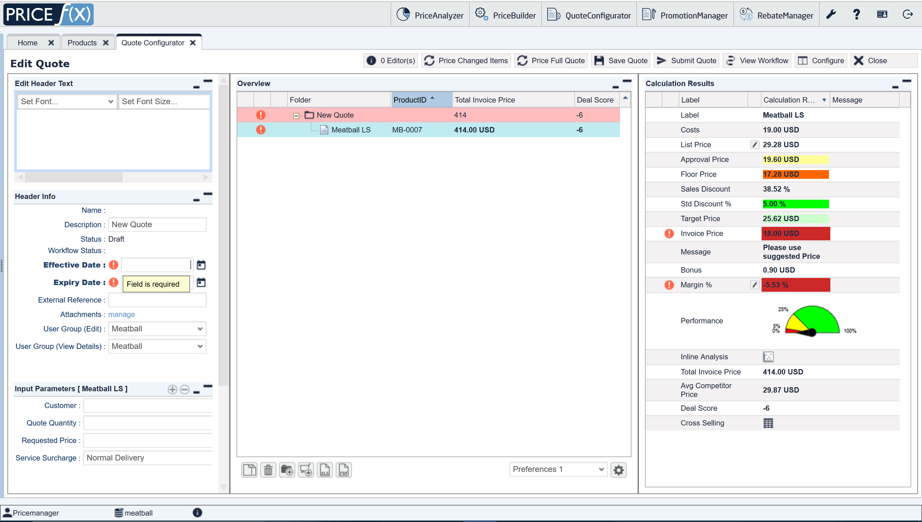
QuoteConfigurator Improvements
Functionality
Quote with Effective Dates and Expiry Dates empty → warning that the fields are mandatory

Slide 29
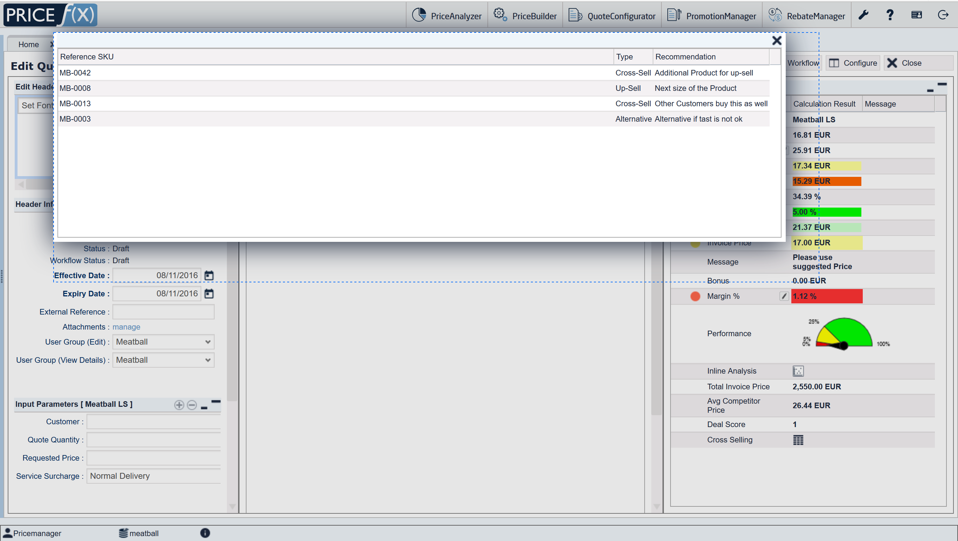
QuoteConfigurator Improvements
Getting Round and Using the App
Resizable Matrix popup windows

Slide 30
RebateManager Improvements
New Integration Status Fields
New customizable fields on the Rebate Record level
To track integration updates
Can be used for filtering

Slide 31
General Improvements
PA Improvements
PB Improvements
QC Improvements
RM Improvements
Other Improvements

Slide 32
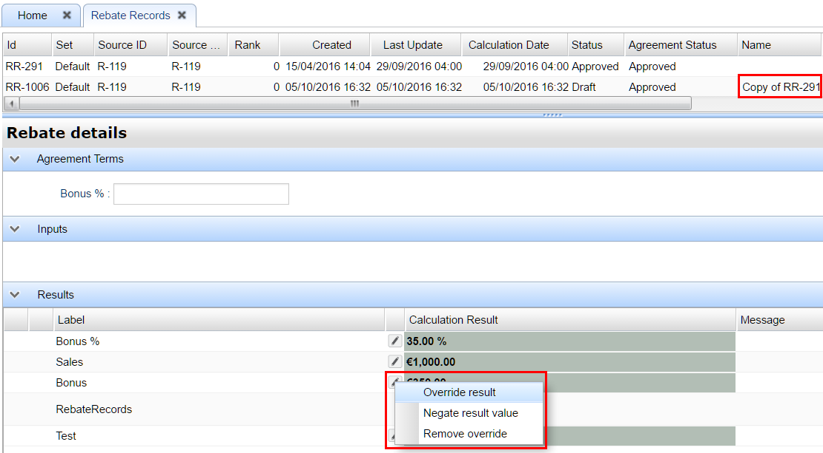
RebateManager Improvements
New Actions for Rebate Records
Copy Rebate Records – copied values in Override status
Revoke an approved Rebate Record
New role for these actions (Rebate Records Admin)

Slide 33
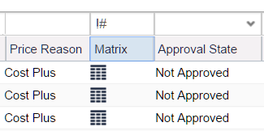
UI Improvements
Getting Round and Using the App
Possible to filter columns for entries with/without a Matrix icon

Slide 34
General Improvements
PA Improvements
PB Improvements
QC Improvements
RM Improvements
Other Improvements

Slide 35
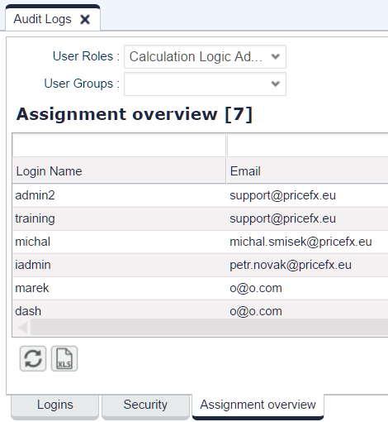
UI Improvements
Getting Round and Using the App
Quick filter for searching a user group added
Possible to view a list of users assigned to a role / user group

Slide 36
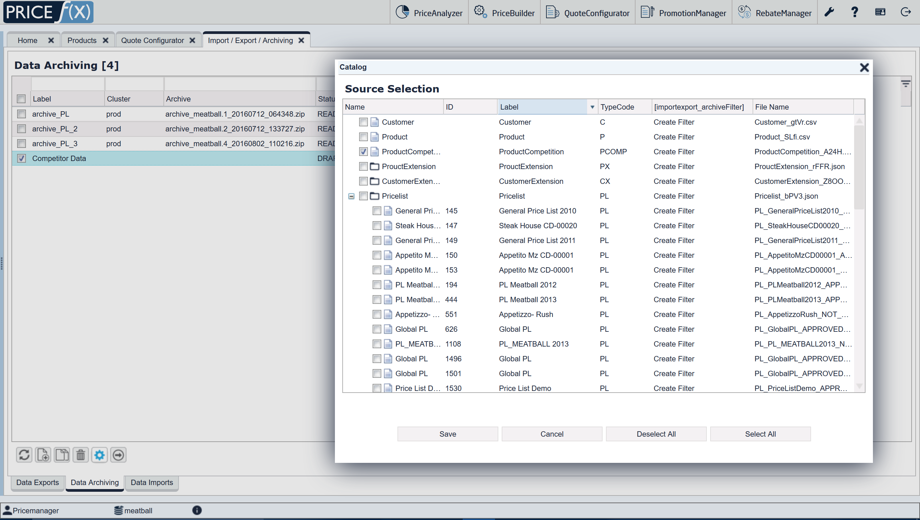
UI Improvements
Functionality
Possible to automate data archiving by using the Calculation Flow

Slide 37
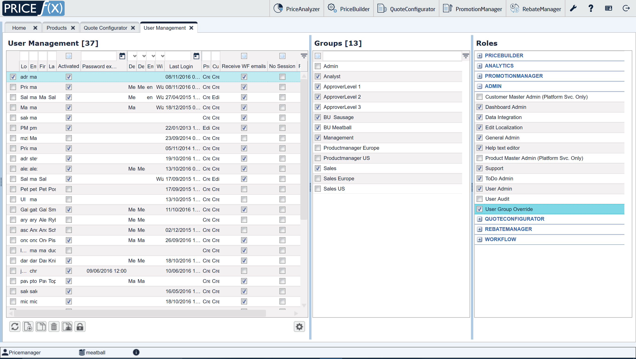
Backend Improvements
Better Performance & Security
New role "User Group Override" – can see all Quotes, Price Lists, etc. but is not a full admin

Slide 38
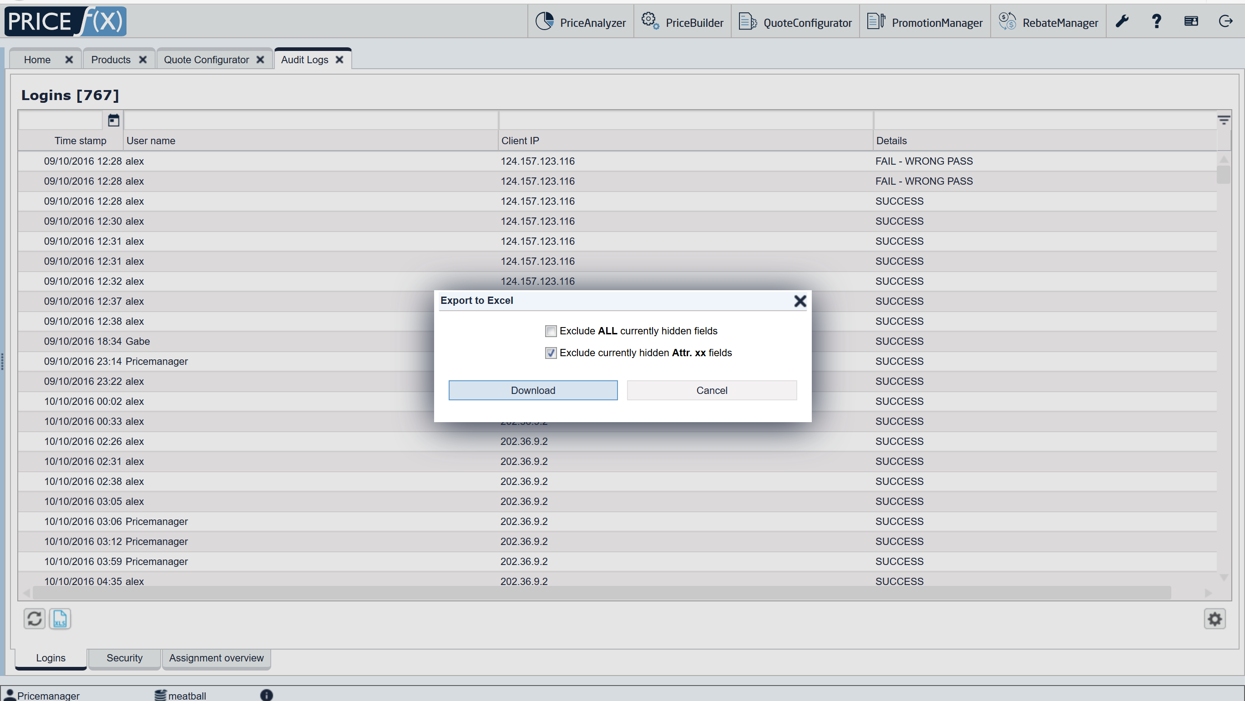
UI Improvements
Functionality
Download the Security log as an Excel file

Slide 39
Backend Improvements
Better Performance & Security
SAML SSO (Single Sign-on) supports multiple identity providers (IdP)

Slide 40
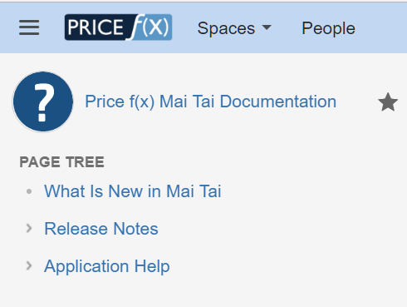
More Information
Price f(x) Universe
https://uni.pricefx.eu
Mai Tai documentation will be available at the time of the release

